Slide 1
uavsizing
a library to size a small UAV

Slide 2
uavsizing.weights

Slide 3
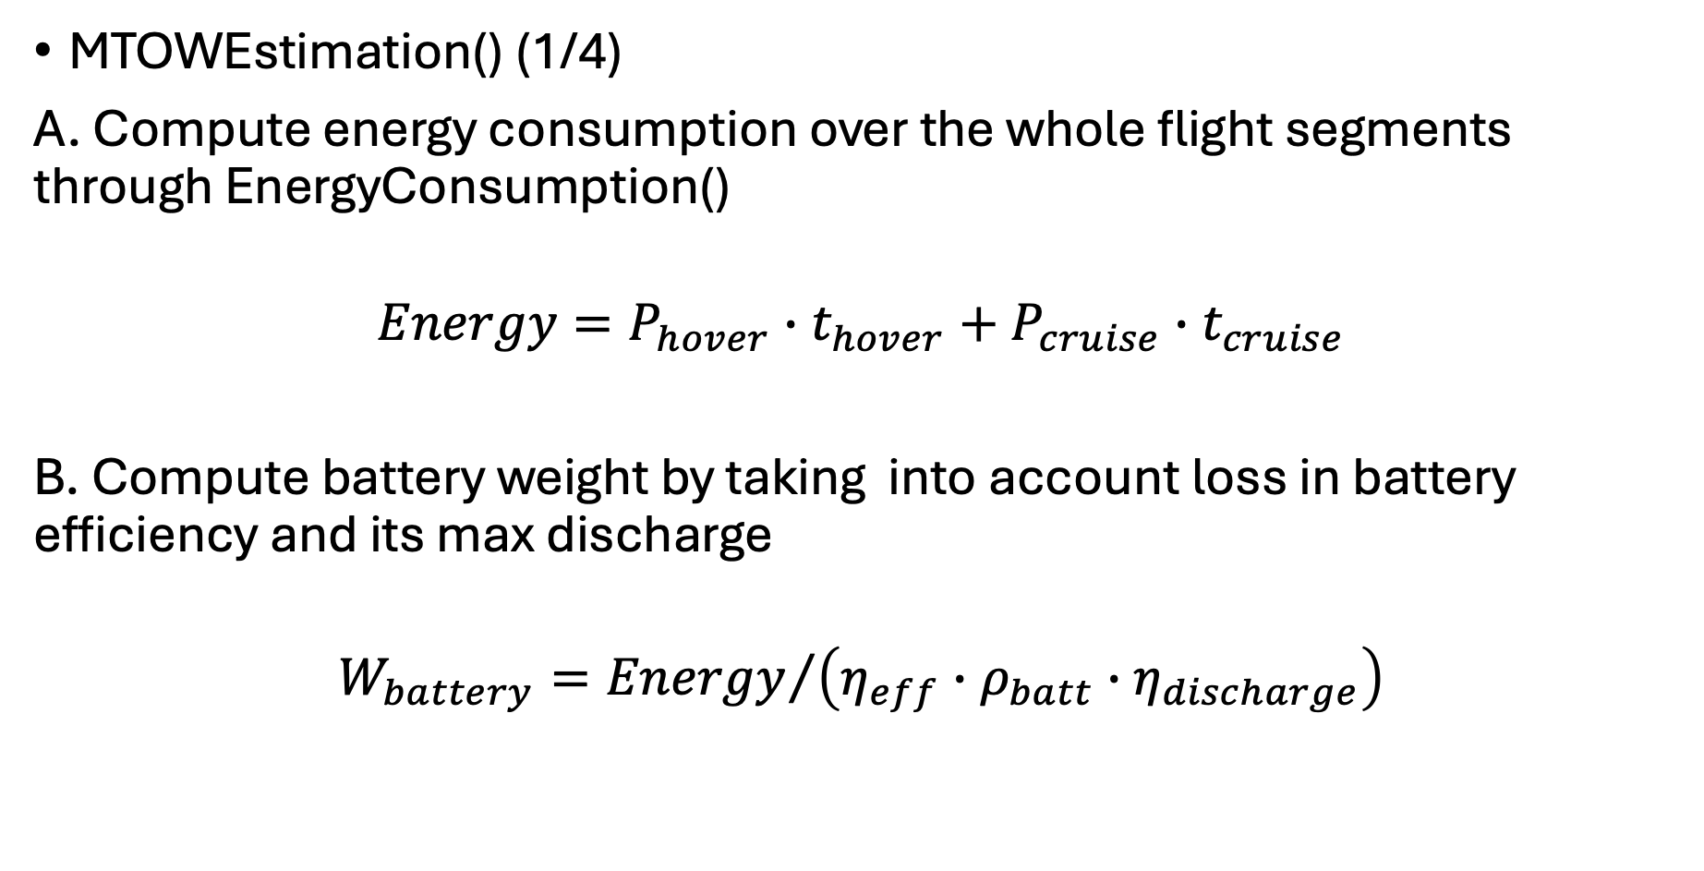
uavsizing.weights
openmdao.api.Group
MTOWEstimation() (1/4)
A. Compute energy consumption over the whole flight segments through EnergyConsumption()
$$Energy=P_{hover}∙t_{hover}+P_{cruise}∙t_{cruise}$$
B. Compute battery weight by taking into account loss in battery efficiency and its max discharge
$$W_{battery}={Energy}/{\left(η_{eff}∙ρ_{batt}∙η_{discharge}\right)}$$

Slide 4
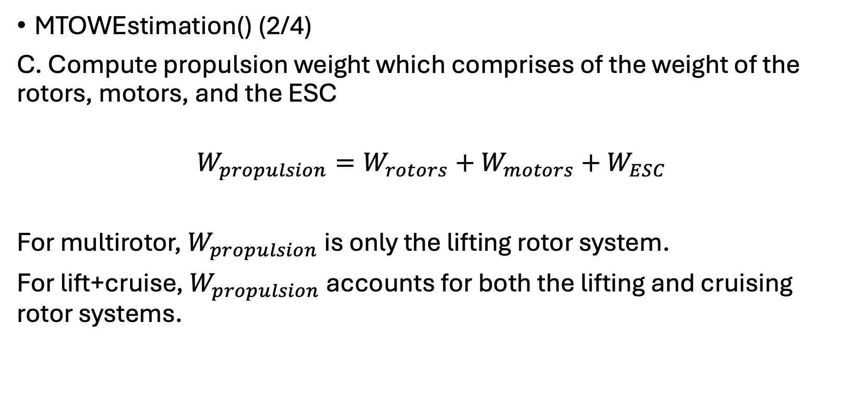
uavsizing.weights
openmdao.api.Group
MTOWEstimation() (2/4)
C. Compute propulsion weight which comprises of the weight of the rotors, motors, and the ESC
$$W_{propulsion}=W_{rotors}+W_{motors}+W_{ESC}$$
For multirotor, $W_{propulsion}$ is only the lifting rotor system.
For lift+cruise, $W_{propulsion}$ accounts for both the lifting and cruising rotor systems.

Slide 5
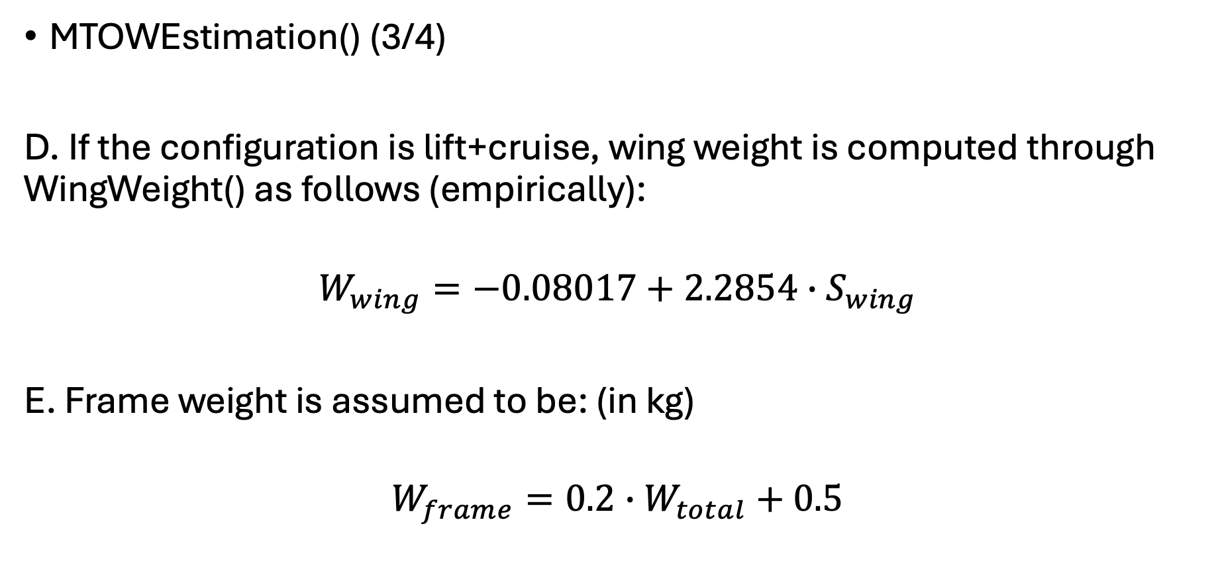
uavsizing.weights
openmdao.api.Group
MTOWEstimation() (3/4)
D. If the configuration is lift+cruise, wing weight is computed through WingWeight() as follows (empirically):
$$W_{wing}=−0.08017+2.2854∙S_{wing}$$
E. Frame weight is assumed to be: (in kg)
$$W_{frame}=0.2∙W_{total}+0.5$$

Slide 6
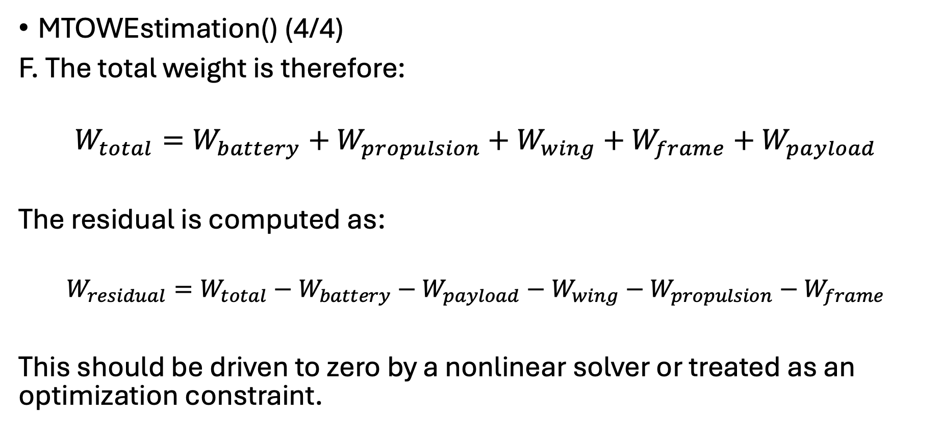
uavsizing.weights
openmdao.api.Group
MTOWEstimation() (4/4)
F. The total weight is therefore:
$$W_{total}=W_{battery}+W_{propulsion}+W_{wing}+W_{frame}+W_{payload}$$
The residual is computed as:
$$W_{residual}=W_{total}−W_{battery}−W_{payload}−W_{wing}−W_{propulsion}−W_{frame}$$
This should be driven to zero by a nonlinear solver or treated as an optimization constraint.

Slide 7
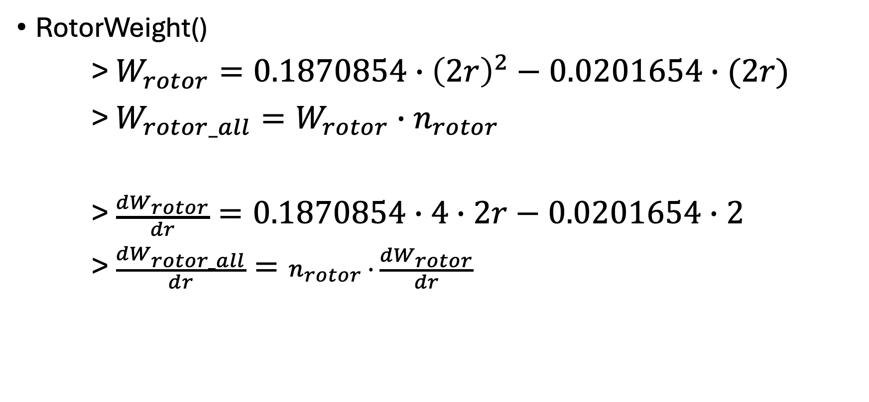
uavsizing.weights
openmdao.api.ExplicitComponent
RotorWeight()
> $W_{rotor}=0.1870854∙{\left(2r\right)}^{2}−0.0201654∙(2r)$
> $W_{rotor_all}=W_{rotor}∙n_{rotor}$
> $\frac{{dW}_{rotor}}{dr}=0.1870854∙4∙2r−0.0201654∙2$
> $\frac{{dW}_{rotor_all}}{dr}=n_{rotor} ∙ \frac{{dW}_{rotor}}{dr}$

Slide 8
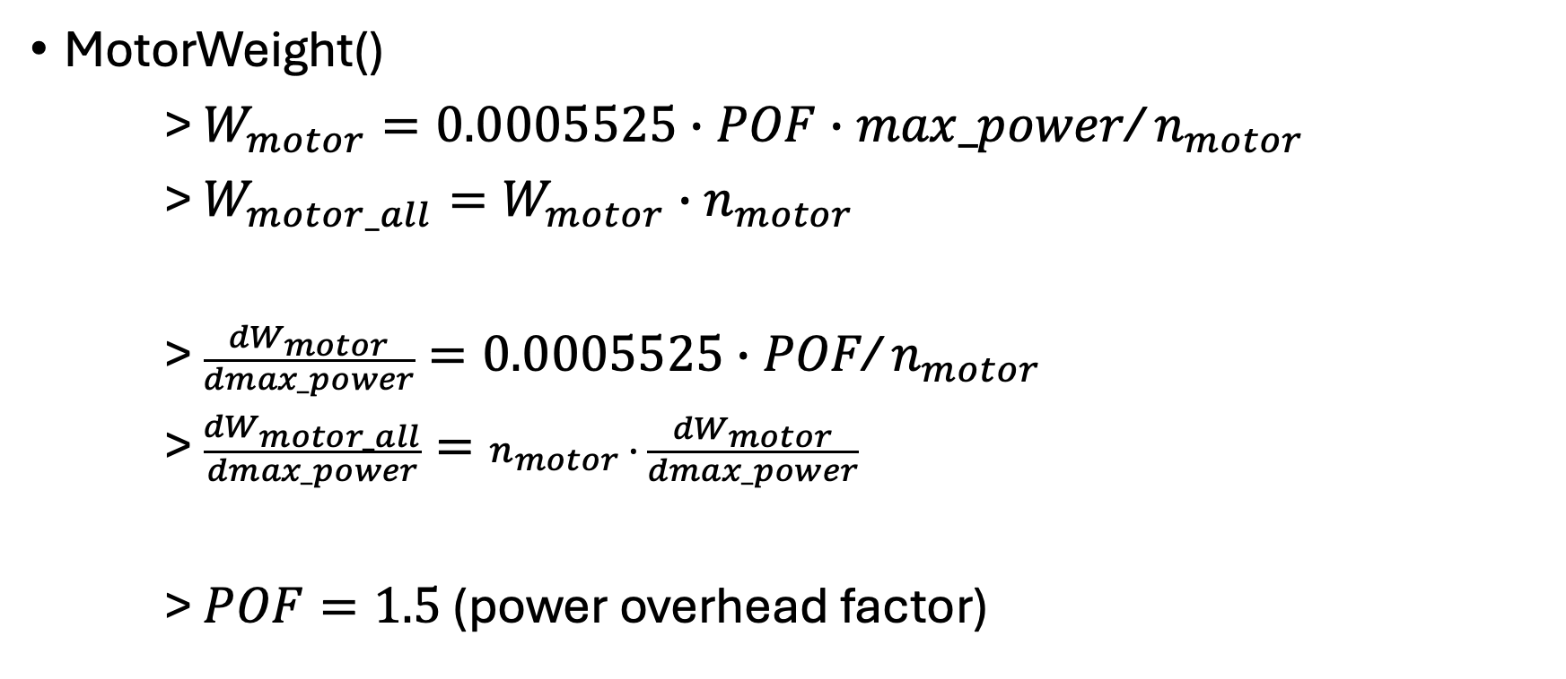
uavsizing.weights
openmdao.api.ExplicitComponent
MotorWeight()
> $W_{motor}=0.0005525∙POF∙max_power$/ $n_{motor}$
> $W_{motor_all}=W_{motor}∙n_{motor}$
> $\frac{{dW}_{motor}}{dmax_power}=0.0005525∙POF\text{/} n_{motor}$
> $\frac{{dW}_{motor_all}}{dmax_power}=n_{motor} ∙ \frac{{dW}_{motor}}{dmax_power}$
> $POF=1.5$ (power overhead factor)

Slide 9
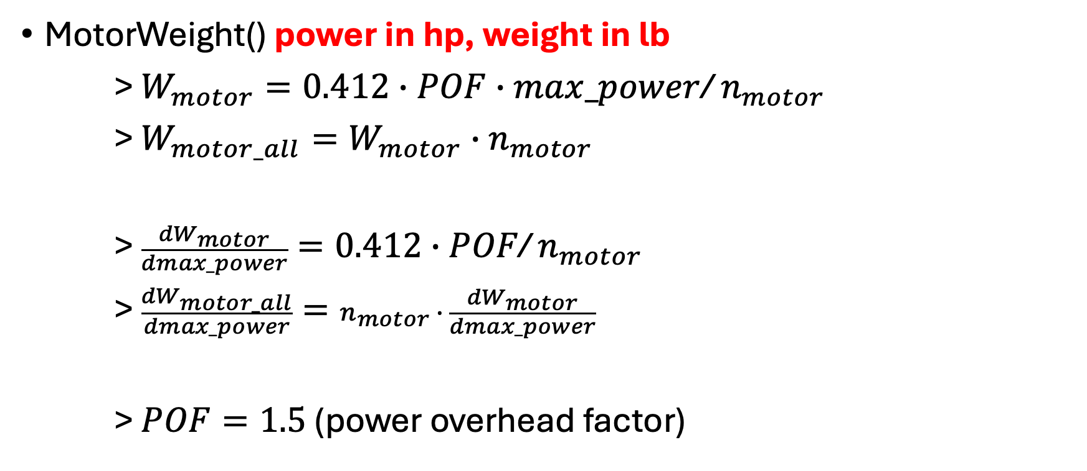
uavsizing.weights
openmdao.api.ExplicitComponent
MotorWeight() power in hp, weight in lb
> $W_{motor}=0.412∙POF∙max_power$/ $n_{motor}$
> $W_{motor_all}=W_{motor}∙n_{motor}$
> $\frac{{dW}_{motor}}{dmax_power}=0.412∙POF\text{/} n_{motor}$
> $\frac{{dW}_{motor_all}}{dmax_power}=n_{motor} ∙ \frac{{dW}_{motor}}{dmax_power}$
> $POF=1.5$ (power overhead factor)

Slide 10
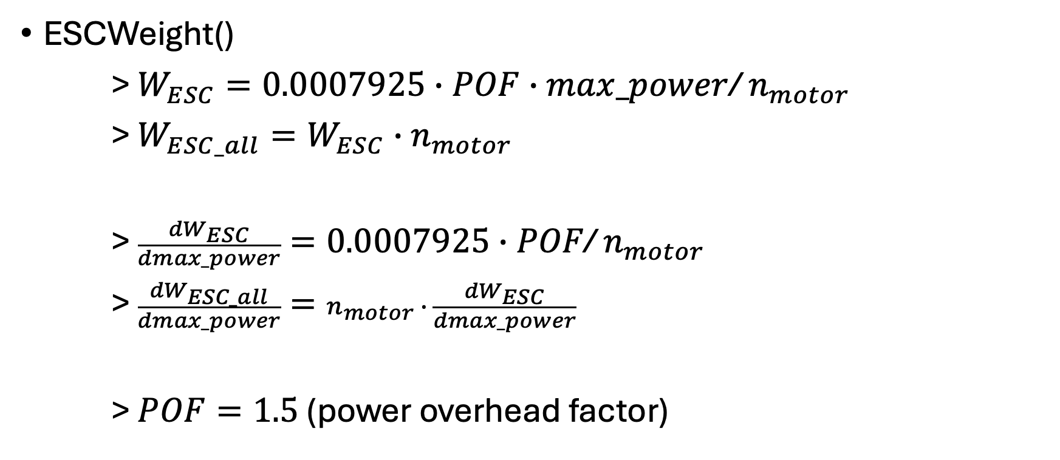
uavsizing.weights
openmdao.api.ExplicitComponent
ESCWeight()
> $W_{ESC}=0.0007925∙POF∙max_power$/ $n_{motor}$
> $W_{ESC_all}=W_{ESC}∙n_{motor}$
> $\frac{{dW}_{ESC}}{dmax_power}=0.0007925∙POF\text{/} n_{motor}$
> $\frac{{dW}_{ESC_all}}{dmax_power}=n_{motor} ∙ \frac{{dW}_{ESC}}{dmax_power}$
> $POF=1.5$ (power overhead factor)

Slide 11
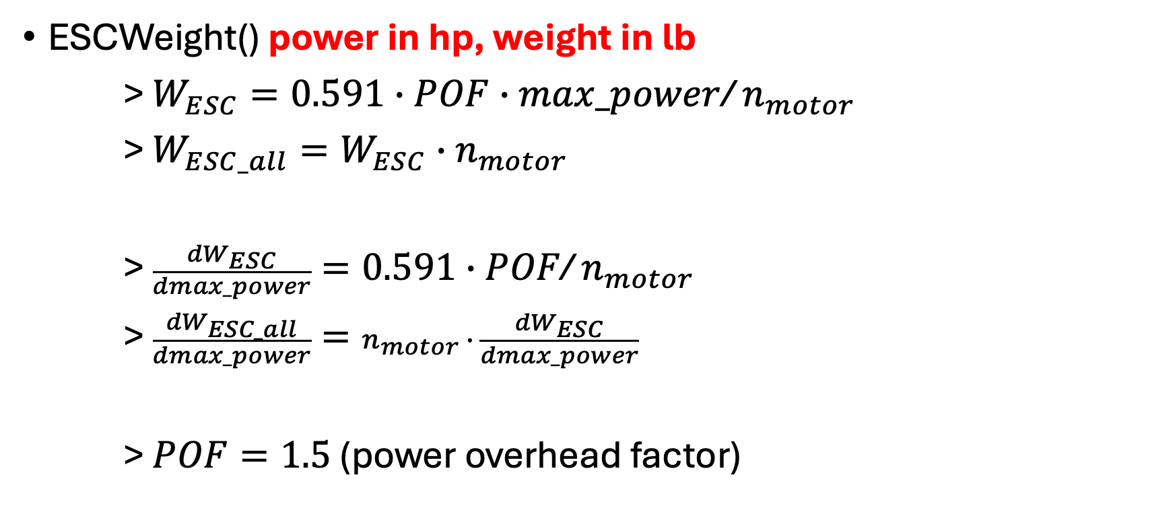
uavsizing.weights
openmdao.api.ExplicitComponent
ESCWeight() power in hp, weight in lb
> $W_{ESC}=0.591∙POF∙max_power$/ $n_{motor}$
> $W_{ESC_all}=W_{ESC}∙n_{motor}$
> $\frac{{dW}_{ESC}}{dmax_power}=0.591∙POF\text{/} n_{motor}$
> $\frac{{dW}_{ESC_all}}{dmax_power}=n_{motor} ∙ \frac{{dW}_{ESC}}{dmax_power}$
> $POF=1.5$ (power overhead factor)

Slide 12
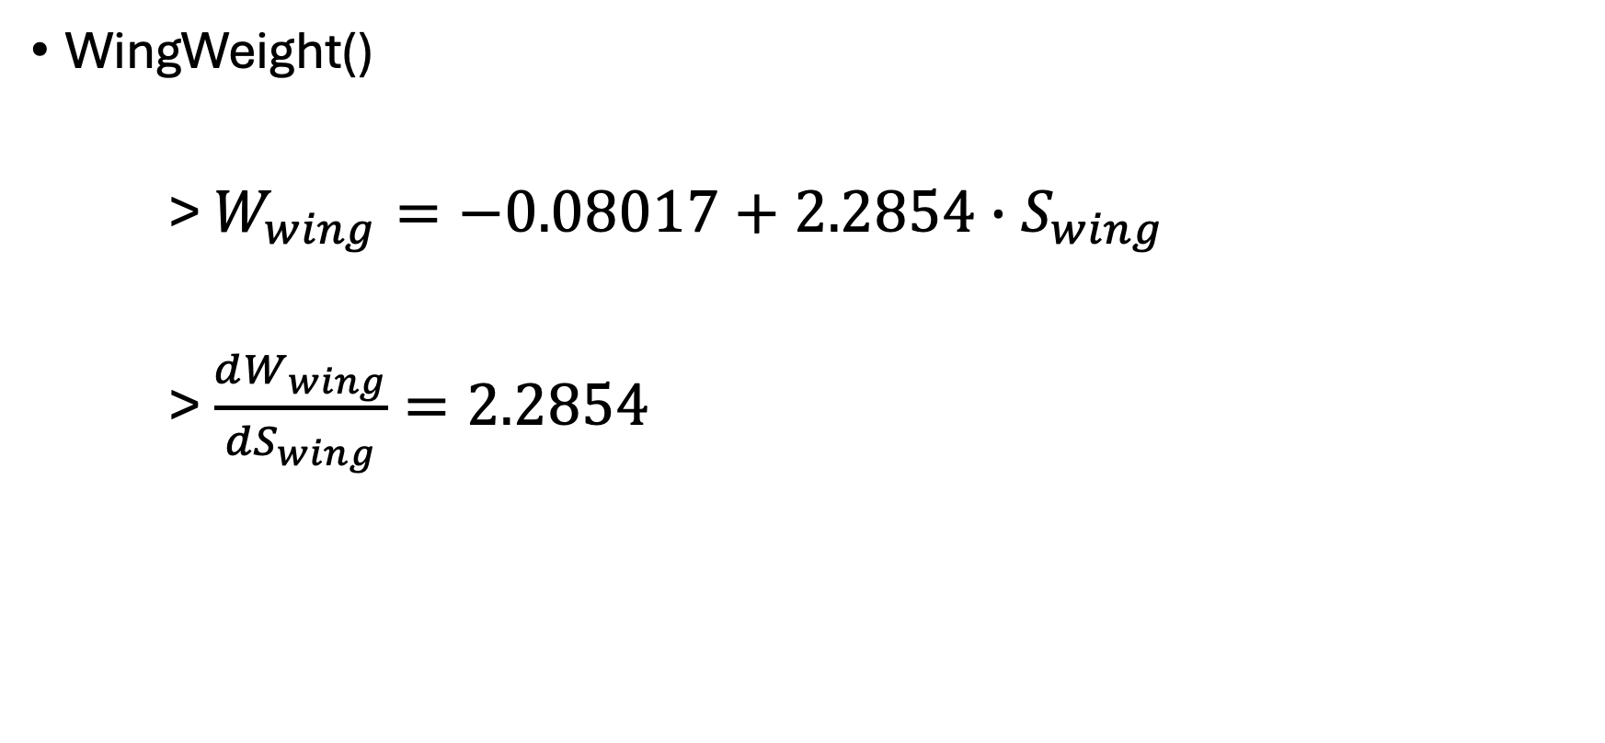
uavsizing.weights
openmdao.api.ExplicitComponent
WingWeight()
> $W_{wing}=−0.08017+2.2854∙S_{wing}$
> $\frac{dW_{wing}}{{dS}_{wing}}=2.2854$

Slide 13
uavsizing.aerodynamics

Slide 14
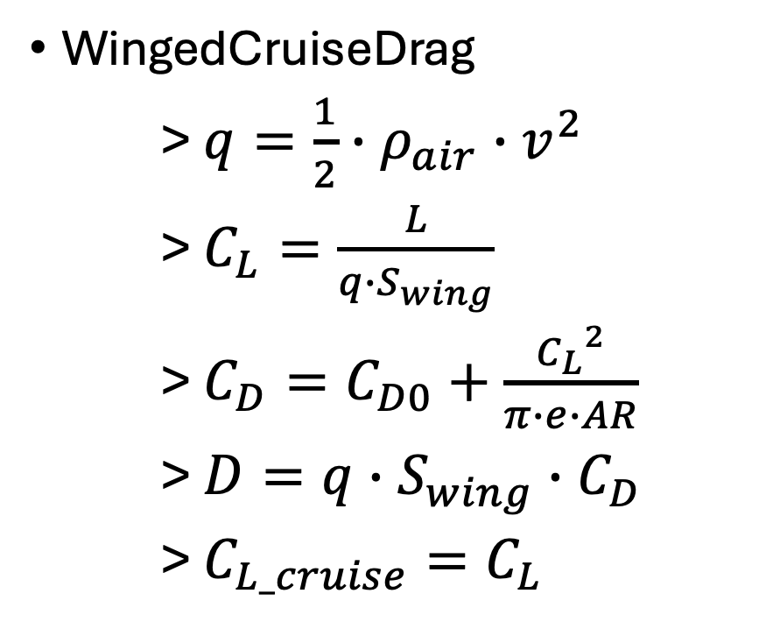
uavsizing.aerodynamics
openmdao.api.ExplicitComponent
WingedCruiseDrag
> $q=\frac{1}{2}∙ρ_{air}∙v^{2}$
> $C_{L}=\frac{L}{q∙S_{wing}}$
> $C_{D}=C_{D0}+\frac{{C_{L}}^{2}}{π∙e∙AR}$
> ${D=q∙S_{wing}∙C}_{D}$
> $C_{L_cruise}=C_{L}$

Slide 15
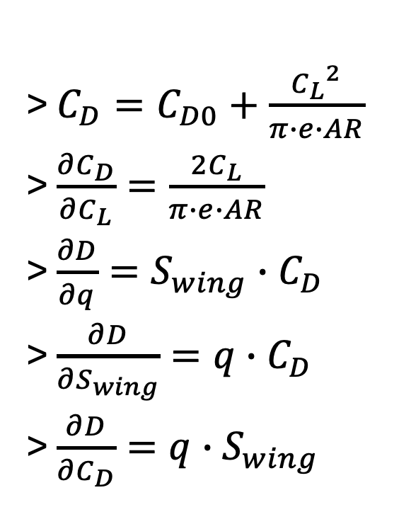
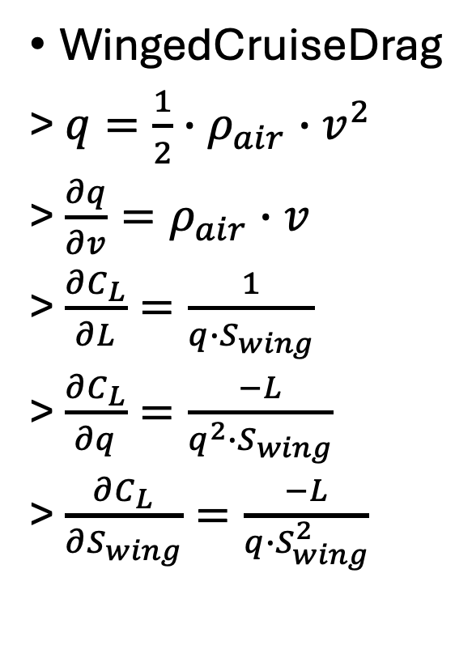
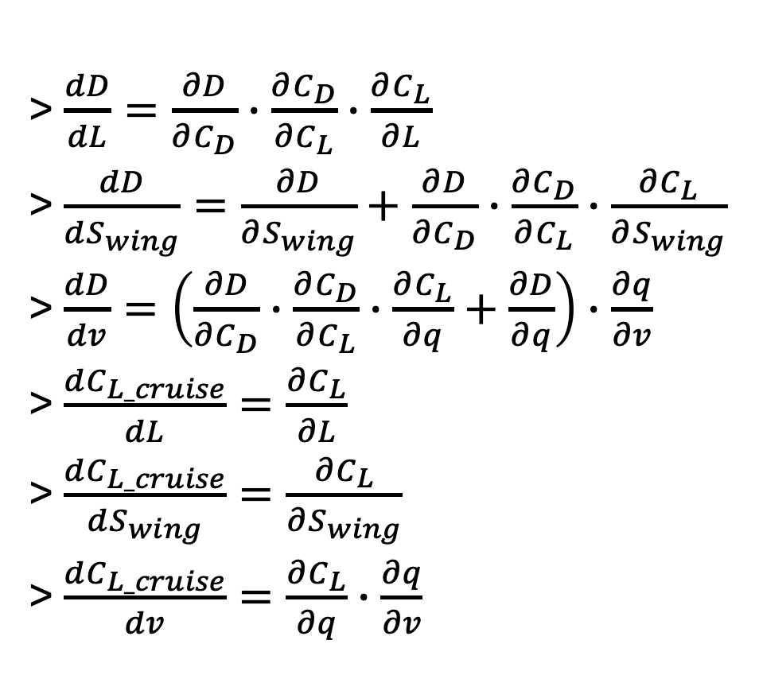
uavsizing.aerodynamics
openmdao.api.ExplicitComponent
WingedCruiseDrag
> $q=\frac{1}{2}∙ρ_{air}∙v^{2}$
> $\frac{∂q}{∂v}=ρ_{air}∙v$
> $\frac{∂C_{L}}{∂L}=\frac{1}{q∙S_{wing}}$
> $\frac{∂C_{L}}{∂q}=\frac{−L}{q^{2}∙S_{wing}}$
> $\frac{∂C_{L}}{∂S_{wing}}=\frac{−L}{q∙S_{wing}^{2}}$
> $C_{D}=C_{D0}+\frac{{C_{L}}^{2}}{π∙e∙AR}$
> $\frac{∂C_{D}}{∂C_{L}}=\frac{2C_{L}}{π∙e∙AR}$
> $\frac{∂D}{∂q}=S_{wing}∙C_{D}$
> $\frac{∂D}{∂S_{wing}}=q∙C_{D}$
> $\frac{∂D}{∂C_{D}}=q∙S_{wing}$
>$\frac{dD}{dL}=\frac{∂D}{∂C_{D}}∙\frac{∂C_{D}}{∂C_{L}}∙\frac{∂C_{L}}{∂L}$
> $\frac{dD}{dS_{wing}}=\frac{∂D}{∂S_{wing}}+\frac{∂D}{∂C_{D}}∙\frac{∂C_{D}}{∂C_{L}}∙\frac{∂C_{L}}{∂S_{wing}}$
> $\frac{dD}{dv}=\left(\frac{∂D}{∂C_{D}}∙\frac{∂C_{D}}{∂C_{L}}∙\frac{∂C_{L}}{∂q}+\frac{∂D}{∂q}\right)∙\frac{∂q}{∂v}$
> $\frac{dC_{L_cruise}}{dL}=\frac{∂C_{L}}{∂L}$
> $\frac{dC_{L_cruise}}{dS_{wing}}=\frac{∂C_{L}}{∂S_{wing}}$
> $\frac{dC_{L_cruise}}{dv}=\frac{∂C_{L}}{∂q}∙\frac{∂q}{∂v}$

Slide 16
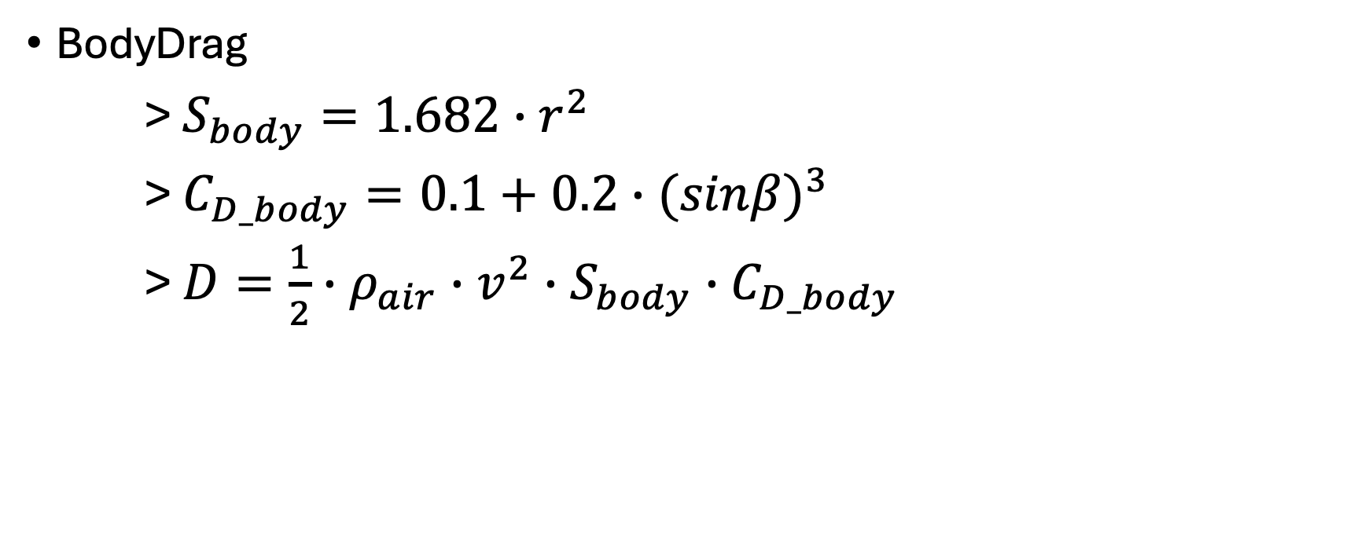
uavsizing.aerodynamics
openmdao.api.ExplicitComponent
BodyDrag
> $S_{body}=1.682∙r^{2}$
> $C_{D_body}=0.1+0.2∙{(sinβ)}^{3}$
> $D=\frac{1}{2}∙ρ_{air}∙v^{2}∙S_{body}∙C_{D_body}$

Slide 17
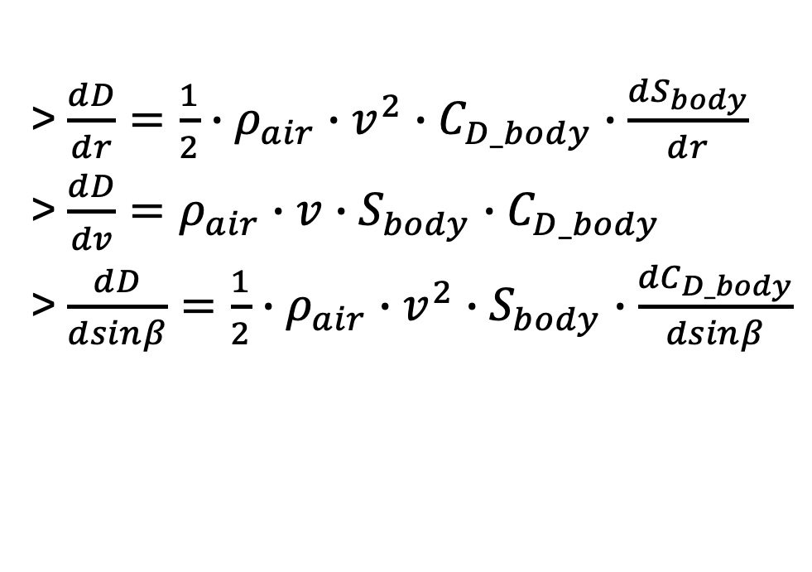
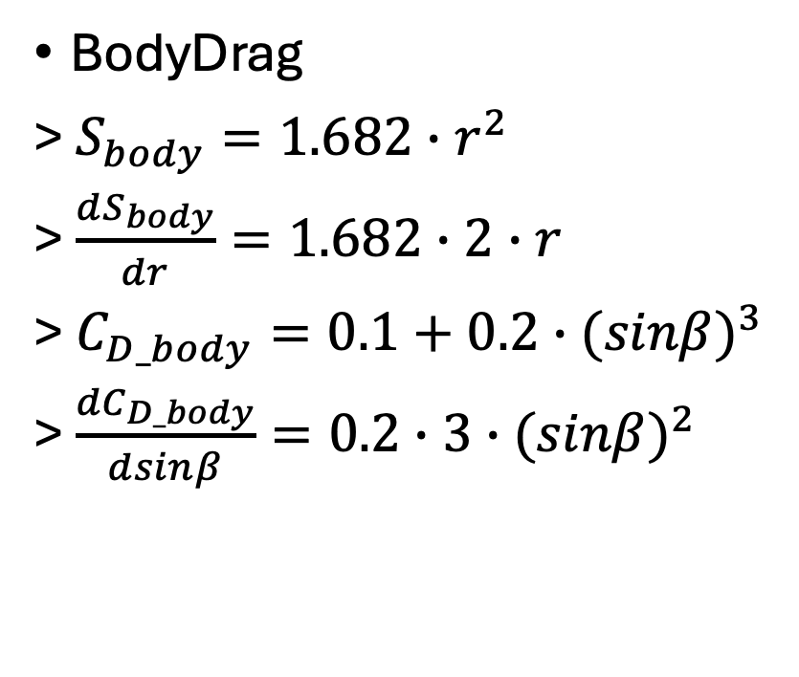
uavsizing.aerodynamics
openmdao.api.ExplicitComponent
BodyDrag
> $S_{body}=1.682∙r^{2}$
> $\frac{dS_{body}}{dr}=1.682∙2∙r$
> $C_{D_body}=0.1+0.2∙{(sinβ)}^{3}$
> $\frac{{dC}_{D_body}}{dsinβ}=0.2∙3∙{(sinβ)}^{2}$
>$\frac{dD}{dr}=\frac{1}{2}∙ρ_{air}∙v^{2}∙C_{D_body}∙\frac{{dS}_{body}}{dr}$
>$\frac{dD}{dv}=ρ_{air}∙v∙S_{body}∙C_{D_body}$
>$\frac{dD}{dsinβ}=\frac{1}{2}∙ρ_{air}∙v^{2}∙S_{body}∙\frac{{dC}_{D_body}}{dsinβ}$

Slide 18
uavsizing.rotors

Slide 19
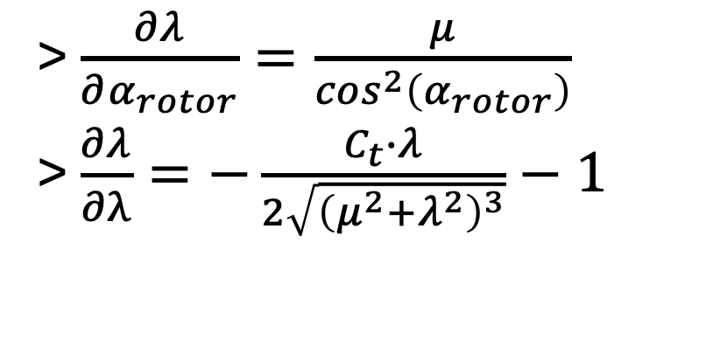
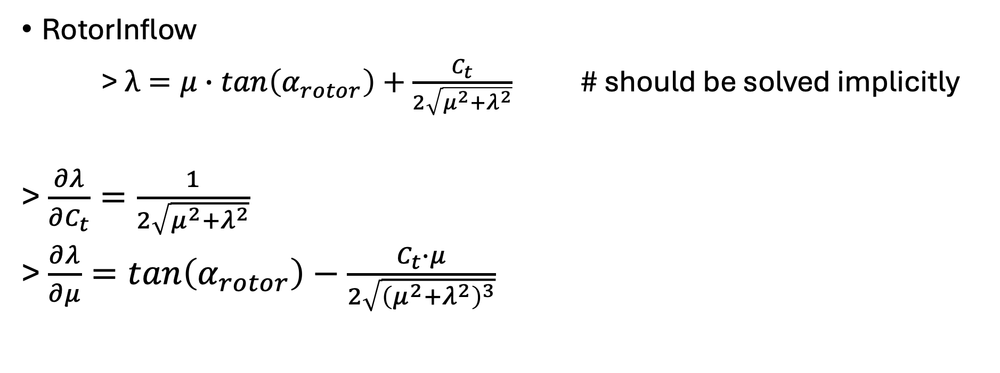
uavsizing.rotors
openmdao.api.ImplicitComponent
RotorInflow
> $λ=μ∙tan\left(α_{rotor}\right)+\frac{C_{t}}{2\sqrt{μ^{2}+λ^{2}}}$ # should be solved implicitly
> $\frac{∂λ}{∂C_{t}}=\frac{1}{2\sqrt{μ^{2}+λ^{2}}}$
> $\frac{∂λ}{∂μ}=tan\left(α_{rotor}\right)−\frac{C_{t}∙μ}{2\sqrt{{\left(μ^{2}+λ^{2}\right)}^{3}}}$
> $\frac{∂λ}{∂α_{rotor}}=\frac{μ}{\cos^{2}\left(α_{rotor}\right)}$
> $\frac{∂λ}{∂λ}=−\frac{C_{t}∙λ}{2\sqrt{{\left(μ^{2}+λ^{2}\right)}^{3}}}−1$

Slide 20
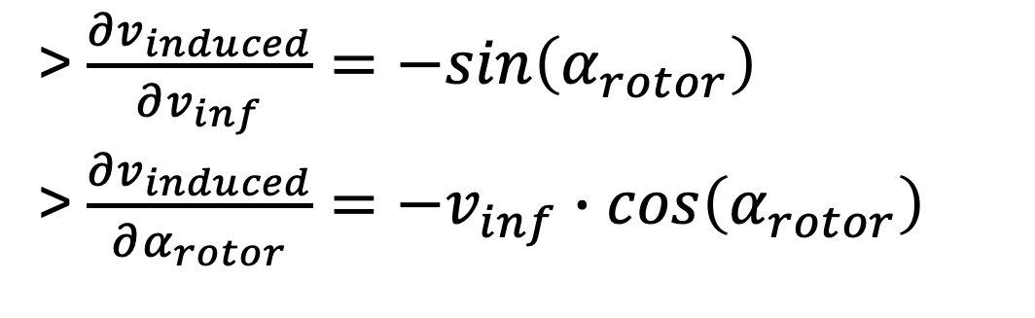
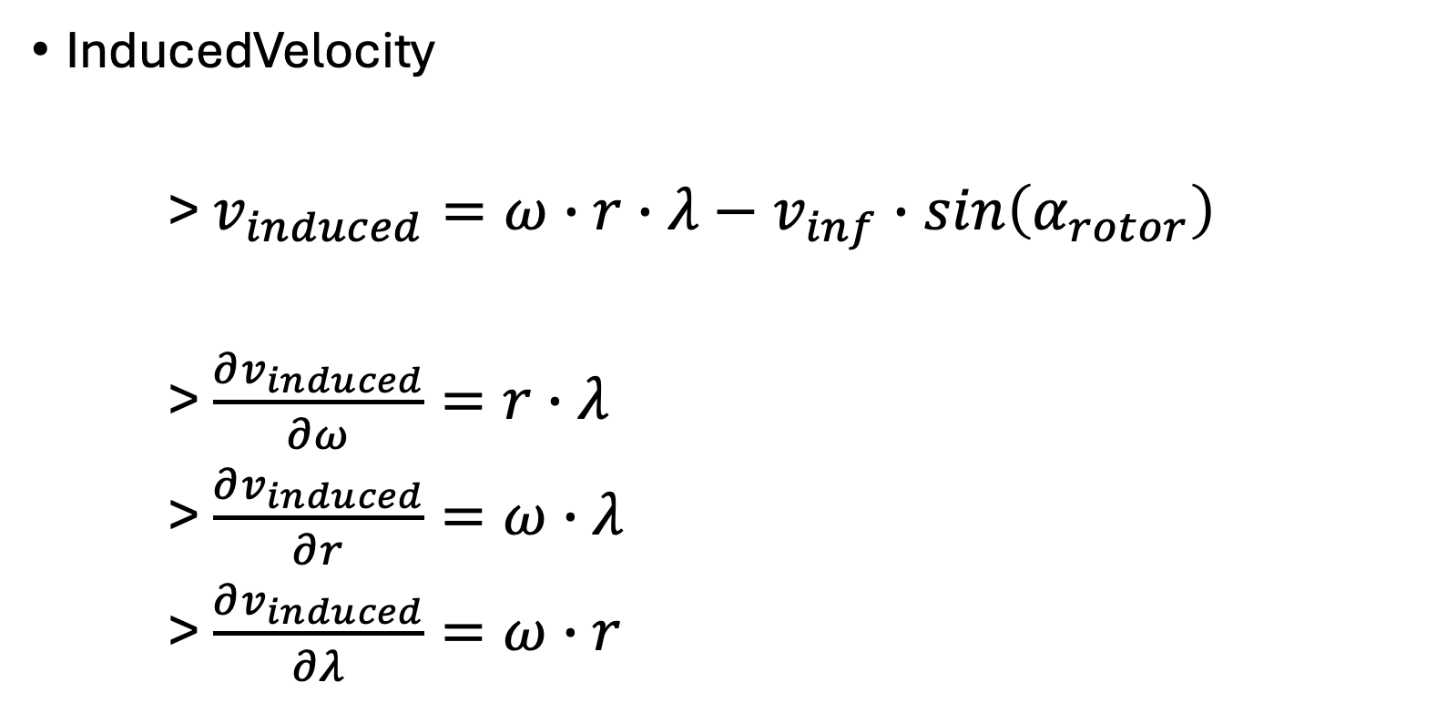
uavsizing.rotors
openmdao.api.ExplicitComponent
InducedVelocity
> $v_{induced}=ω∙r∙λ−v_{inf}∙sin\left(α_{rotor}\right)$
> $\frac{∂v_{induced}}{∂ω}=r∙λ$
> $\frac{∂v_{induced}}{∂r}=ω∙λ$
> $\frac{∂v_{induced}}{∂λ}=ω∙r$
> $\frac{∂v_{induced}}{∂v_{inf}}=−sin\left(α_{rotor}\right)$
> $\frac{∂v_{induced}}{∂α_{rotor}}=−v_{inf}∙cos\left(α_{rotor}\right)$

Slide 21
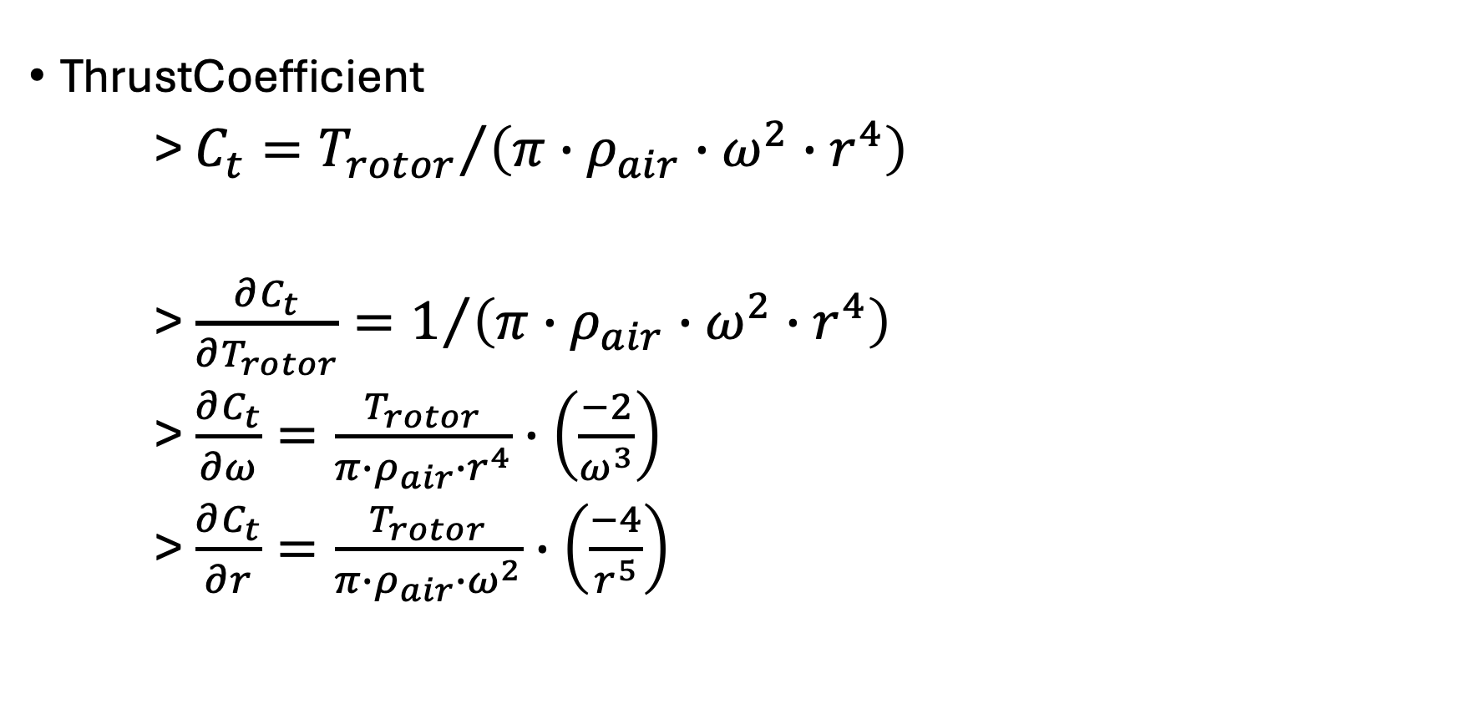
uavsizing.rotors
openmdao.api.ExplicitComponent
ThrustCoefficient
> $C_{t}={T_{rotor}}/{\left(π∙ρ_{air}∙ω^{2}∙r^{4}\right)}$
> $\frac{∂C_{t}}{∂T_{rotor}}=1/{\left(π∙ρ_{air}∙ω^{2}∙r^{4}\right)}$
> $\frac{∂C_{t}}{∂ω}=\frac{T_{rotor}}{π∙ρ_{air}∙r^{4}}∙\left(\frac{−2}{ω^{3}}\right)$
> $\frac{∂C_{t}}{∂r}=\frac{T_{rotor}}{π∙ρ_{air}∙ω^{2}}∙\left(\frac{−4}{r^{5}}\right)$

Slide 22
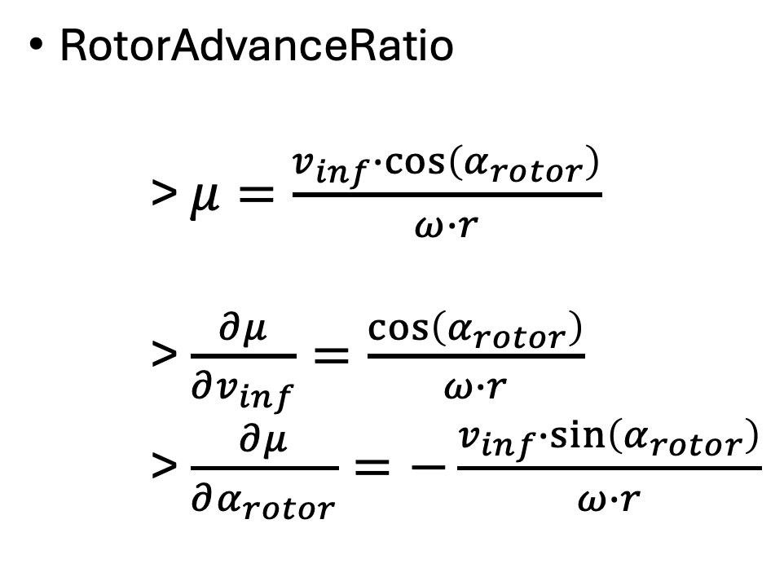
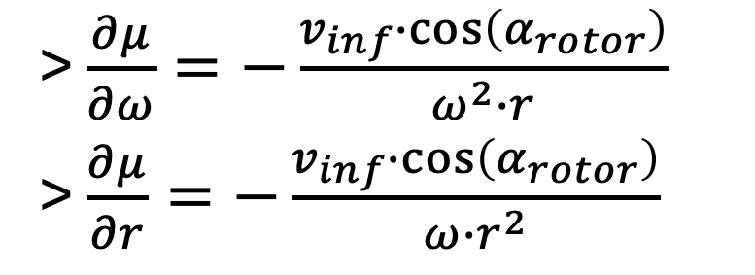
uavsizing.rotors
openmdao.api.ExplicitComponent
RotorAdvanceRatio
> $μ=\frac{v_{inf}∙\cos\left(α_{rotor}\right)}{ω∙r}$
> $\frac{∂μ}{∂v_{inf}}=\frac{\cos\left(α_{rotor}\right)}{ω∙r}$
> $\frac{∂μ}{∂α_{rotor}}=−\frac{v_{inf}∙\sin\left(α_{rotor}\right)}{ω∙r}$
> $\frac{∂μ}{∂ω}=−\frac{v_{inf}∙\cos\left(α_{rotor}\right)}{ω^{2}∙r}$
> $\frac{∂μ}{∂r}=−\frac{v_{inf}∙\cos\left(α_{rotor}\right)}{ω∙r^{2}}$

Slide 23
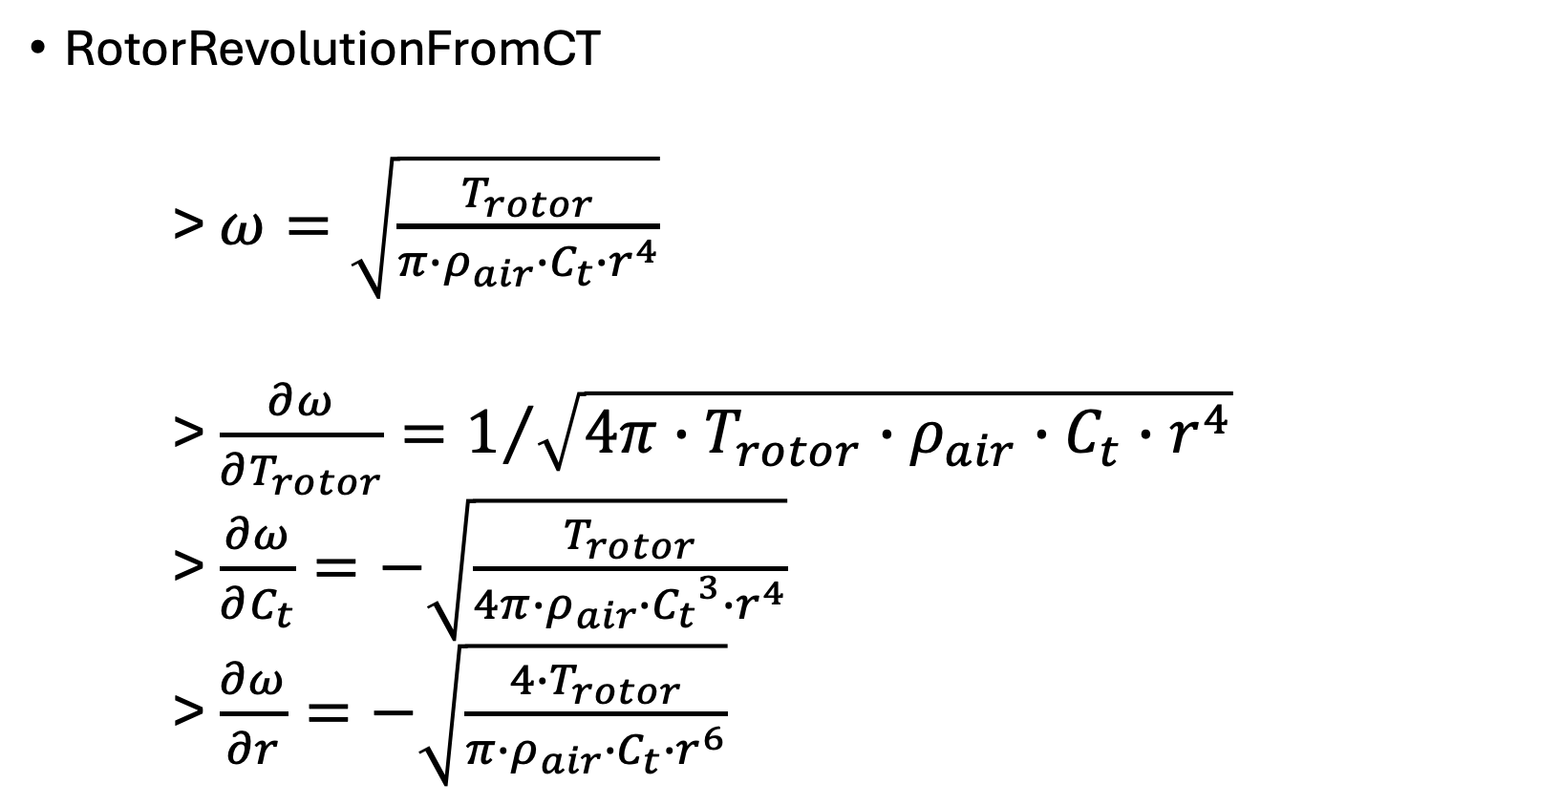
uavsizing.rotors
openmdao.api.ExplicitComponent
RotorRevolutionFromCT
> $ω=\sqrt{\frac{T_{rotor}}{π∙ρ_{air}∙C_{t}∙r^{4}}}$
> $\frac{∂ω}{∂T_{rotor}}=1/{\sqrt{4π∙T_{rotor}∙ρ_{air}∙C_{t}∙r^{4}}}$
> $\frac{∂ω}{∂C_{t}}=−\sqrt{\frac{T_{rotor}}{4π∙ρ_{air}∙{C_{t}}^{3}∙r^{4}}}$
> $\frac{∂ω}{∂r}=−\sqrt{\frac{4∙T_{rotor}}{π∙ρ_{air}∙C_{t}∙r^{6}}}$

Slide 24
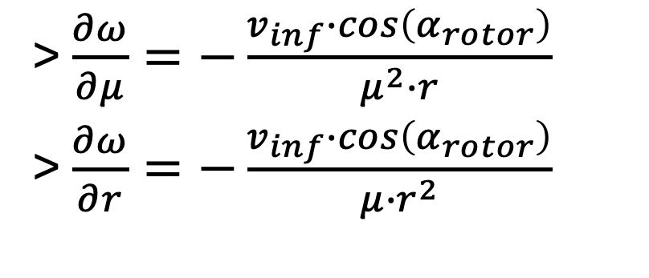
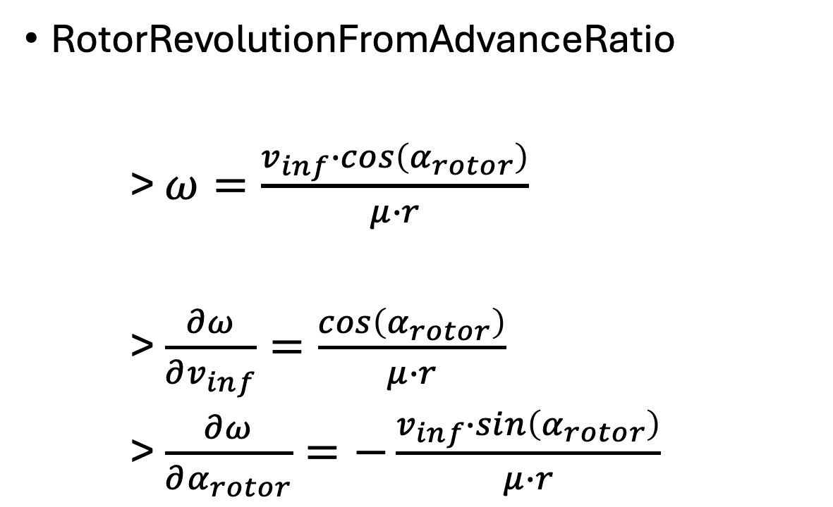
uavsizing.rotors
openmdao.api.ExplicitComponent
RotorRevolutionFromAdvanceRatio
> $ω=\frac{v_{inf}∙cos\left(α_{rotor}\right)}{μ∙r}$
> $\frac{∂ω}{∂v_{inf}}=\frac{cos\left(α_{rotor}\right)}{μ∙r}$
> $\frac{∂ω}{∂α_{rotor}}=−\frac{v_{inf}∙sin\left(α_{rotor}\right)}{μ∙r}$
> $\frac{∂ω}{∂μ}=−\frac{v_{inf}∙cos\left(α_{rotor}\right)}{μ^{2}∙r}$
> $\frac{∂ω}{∂r}=−\frac{v_{inf}∙cos\left(α_{rotor}\right)}{μ∙r^{2}}$

Slide 25
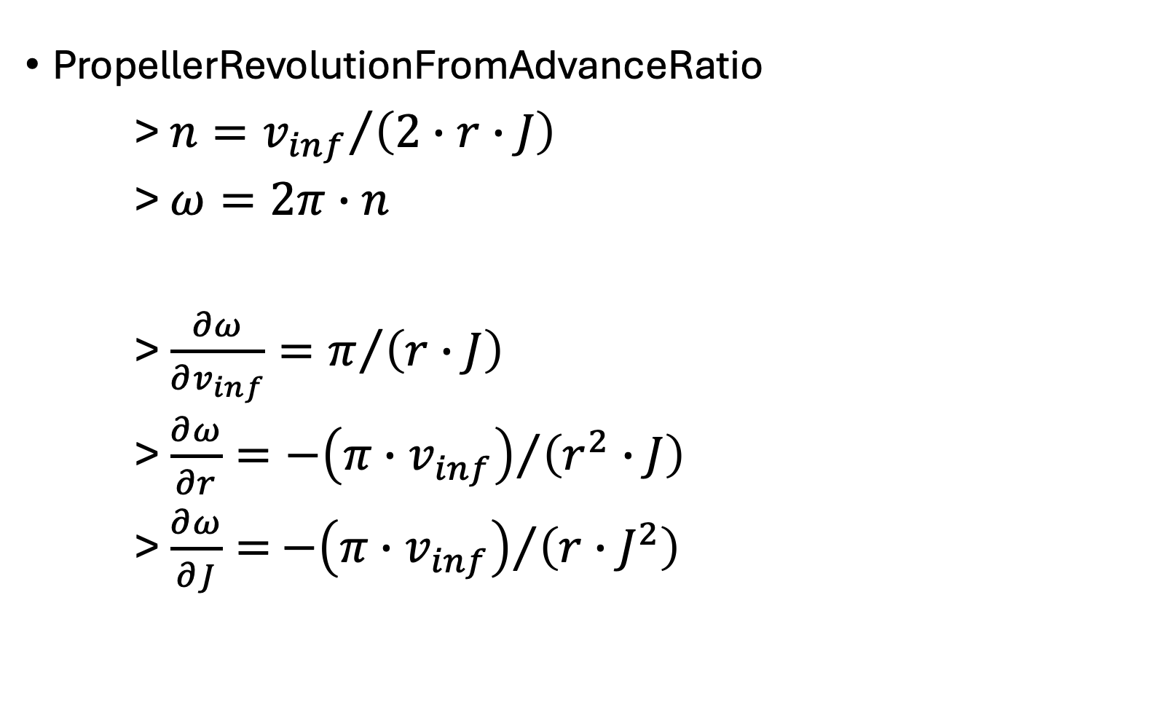
uavsizing.rotors
openmdao.api.ExplicitComponent
PropellerRevolutionFromAdvanceRatio
> ${n=v_{inf}}/{\left(2∙r∙J\right)}$
> $ω=2π∙n$
> $\frac{∂ω}{∂v_{inf}}=π/{\left(r∙J\right)}$
> $\frac{∂ω}{∂r}={−\left({π∙v}_{inf}\right)}/{\left(r^{2}∙J\right)}$
> $\frac{∂ω}{∂J}=$ ${−\left({π∙v}_{inf}\right)}/{\left(r∙J^{2}\right)}$

Slide 26
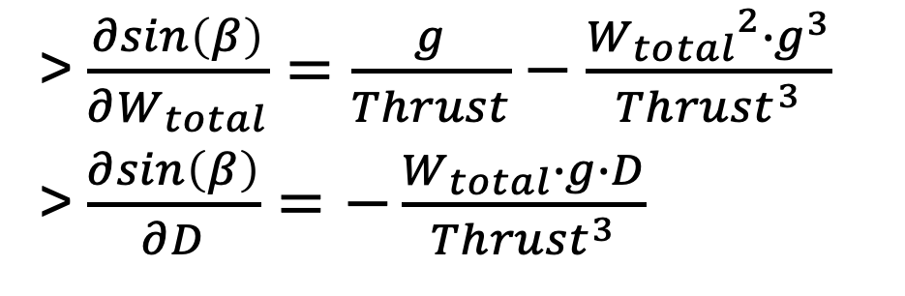
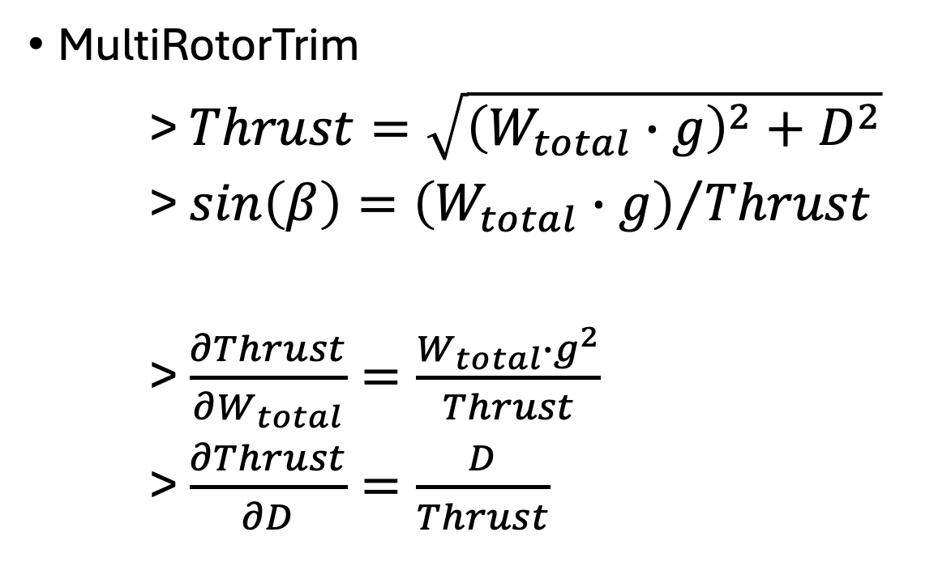
uavsizing.rotors
openmdao.api.ExplicitComponent
MultiRotorTrim
> $Thrust=\sqrt{{\left(W_{total}∙g\right)}^{2}+D^{2}}$
> $sin\left(β\right)={\left(W_{total}∙g\right)}/{Thrust}$
> $\frac{∂Thrust}{∂W_{total}}=\frac{W_{total}∙g^{2}}{Thrust}$
> $\frac{∂Thrust}{∂D}=\frac{D}{Thrust}$
> $\frac{∂sin\left(β\right)}{∂W_{total}}=\frac{g}{Thrust}−\frac{{W_{total}}^{2}∙g^{3}}{Thrust^{3}}$
> $\frac{∂sin\left(β\right)}{∂D}=−\frac{W_{total}∙g∙D}{Thrust^{3}}$

Slide 27
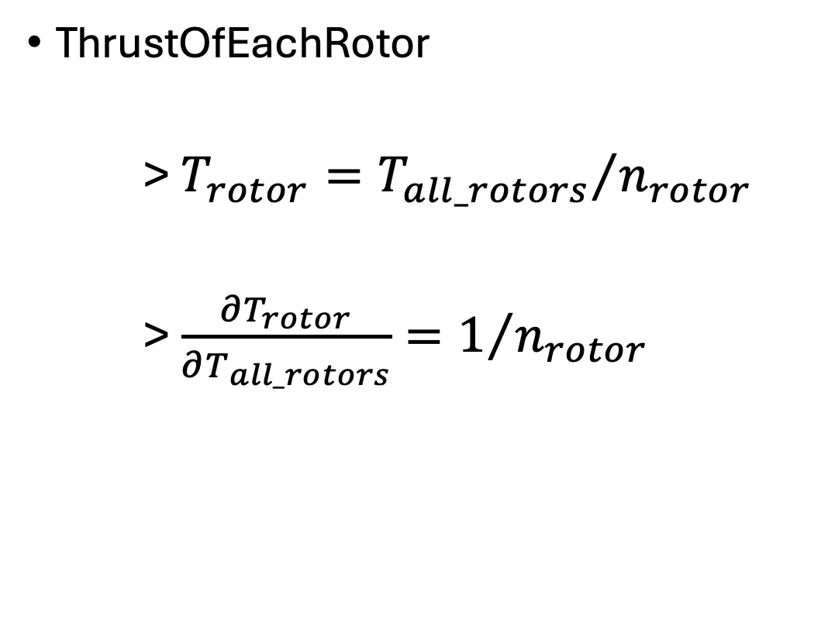
uavsizing.rotors
openmdao.api.ExplicitComponent
ThrustOfEachRotor
> $T_{rotor}={T_{all_rotors}}/{n_{rotor}}$
> $\frac{∂T_{rotor}}{∂T_{all_rotors}}=1/{n_{rotor}}$

Slide 28
uavsizing.powers

Slide 29
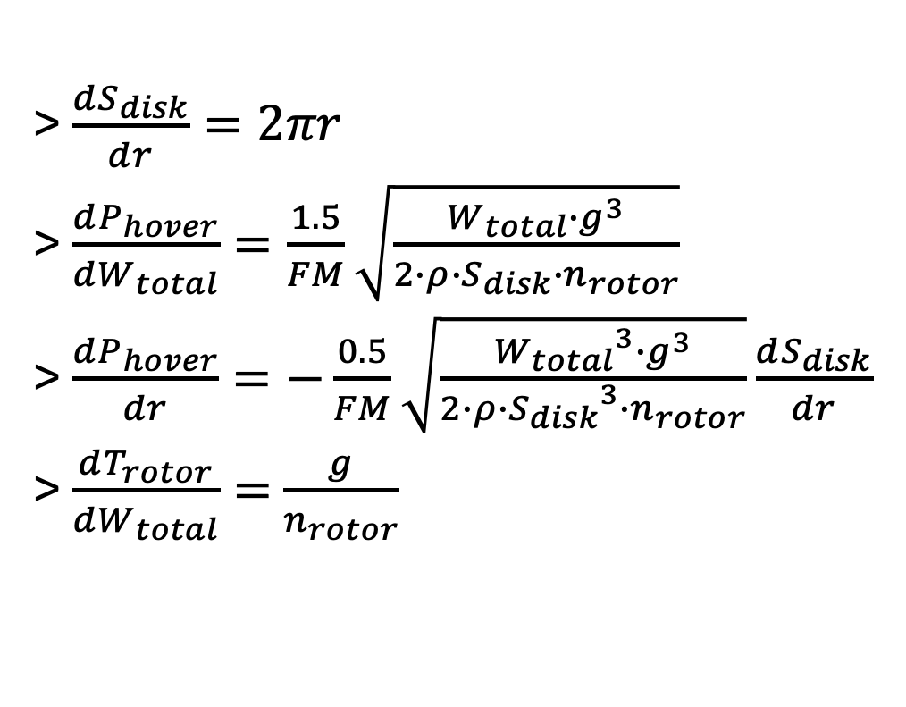
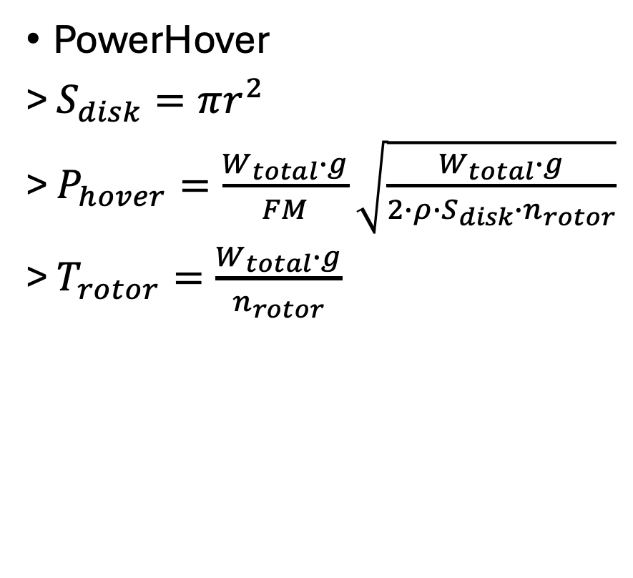
uavsizing.powers
openmdao.api.ExplicitComponent
PowerHover
> $S_{disk}=πr^{2}$
> $P_{hover}=\frac{W_{total}∙g}{FM}\sqrt{\frac{W_{total}∙g}{2∙ρ∙S_{disk}∙n_{rotor}}}$
> $T_{rotor}=\frac{W_{total}∙g}{n_{rotor}}$
> $\frac{dS_{disk}}{dr}=2πr$
> $\frac{dP_{hover}}{dW_{total}}=\frac{1.5}{FM}\sqrt{\frac{W_{total}∙g^{3}}{2∙ρ∙S_{disk}∙n_{rotor}}}$
> $\frac{dP_{hover}}{dr}=−\frac{0.5}{FM}\sqrt{\frac{{W_{total}}^{3}∙g^{3}}{2∙ρ∙{{S_{disk}}^{3}∙n}_{rotor}}}\frac{dS_{disk}}{dr}$
> $\frac{dT_{rotor}}{dW_{total}}=$ $\frac{g}{n_{rotor}}$

Slide 30
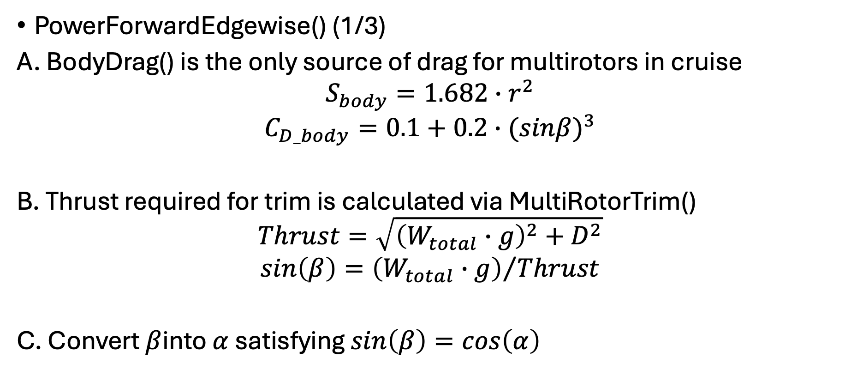
uavsizing.powers
openmdao.api.Group
PowerForwardEdgewise() (1/3)
A. BodyDrag() is the only source of drag for multirotors in cruise
$$S_{body}=1.682∙r^{2}$$
$$C_{D_body}=0.1+0.2∙{(sinβ)}^{3}$$
B. Thrust required for trim is calculated via MultiRotorTrim()
$$Thrust=\sqrt{{\left(W_{total}∙g\right)}^{2}+D^{2}}$$
$$sin\left(β\right)={\left(W_{total}∙g\right)}/{Thrust}$$
C. Convert $β$into $α$ satisfying $sin\left(β\right)=cos\left(α\right)$

Slide 31
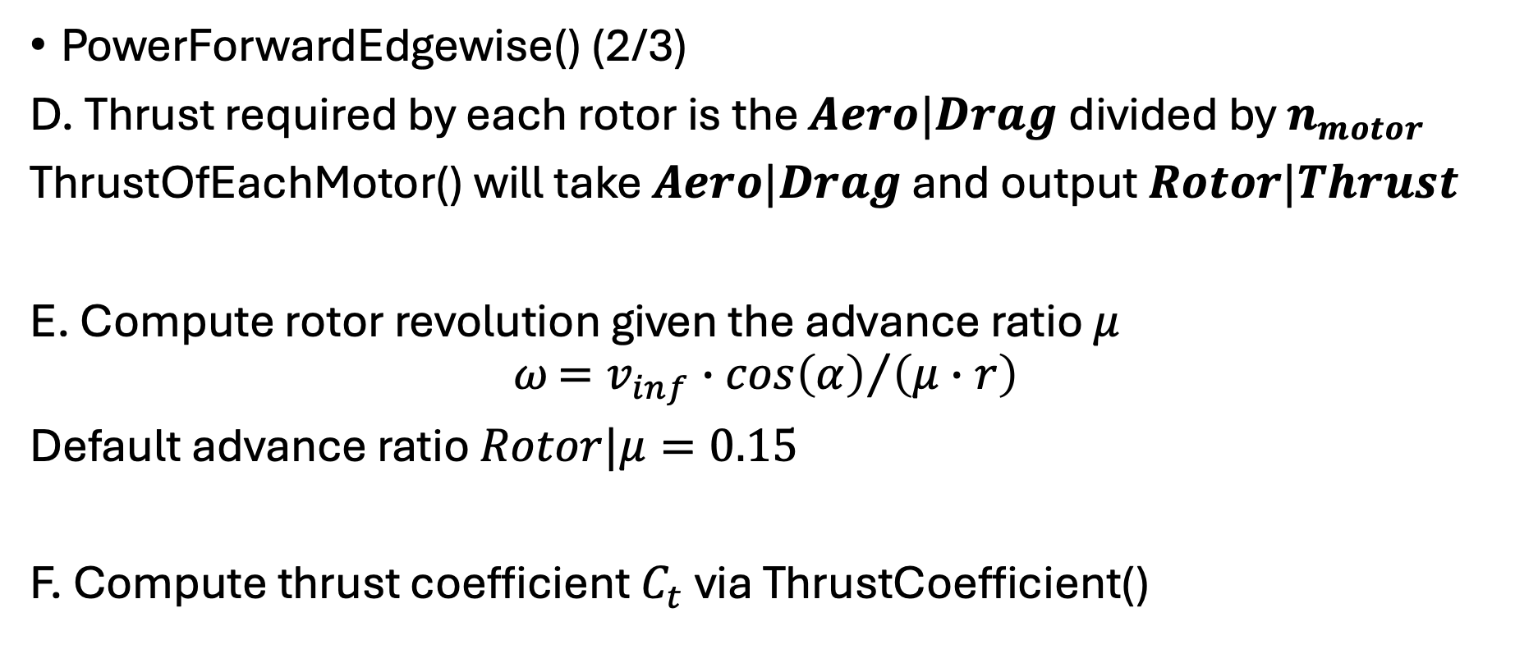
uavsizing.powers
openmdao.api.Group
PowerForwardEdgewise() (2/3)
D. Thrust required by each rotor is the $Aero|Drag$ divided by $n_{motor}$
ThrustOfEachMotor() will take $Aero|Drag$ and output $Rotor|Thrust$
E. Compute rotor revolution given the advance ratio $μ$
$$ω{=v_{inf}∙cos\left(α\right)}/{\left(μ∙r\right)}$$
Default advance ratio $Rotor|μ=0.15$
F. Compute thrust coefficient $C_{t}$ via ThrustCoefficient()

Slide 32
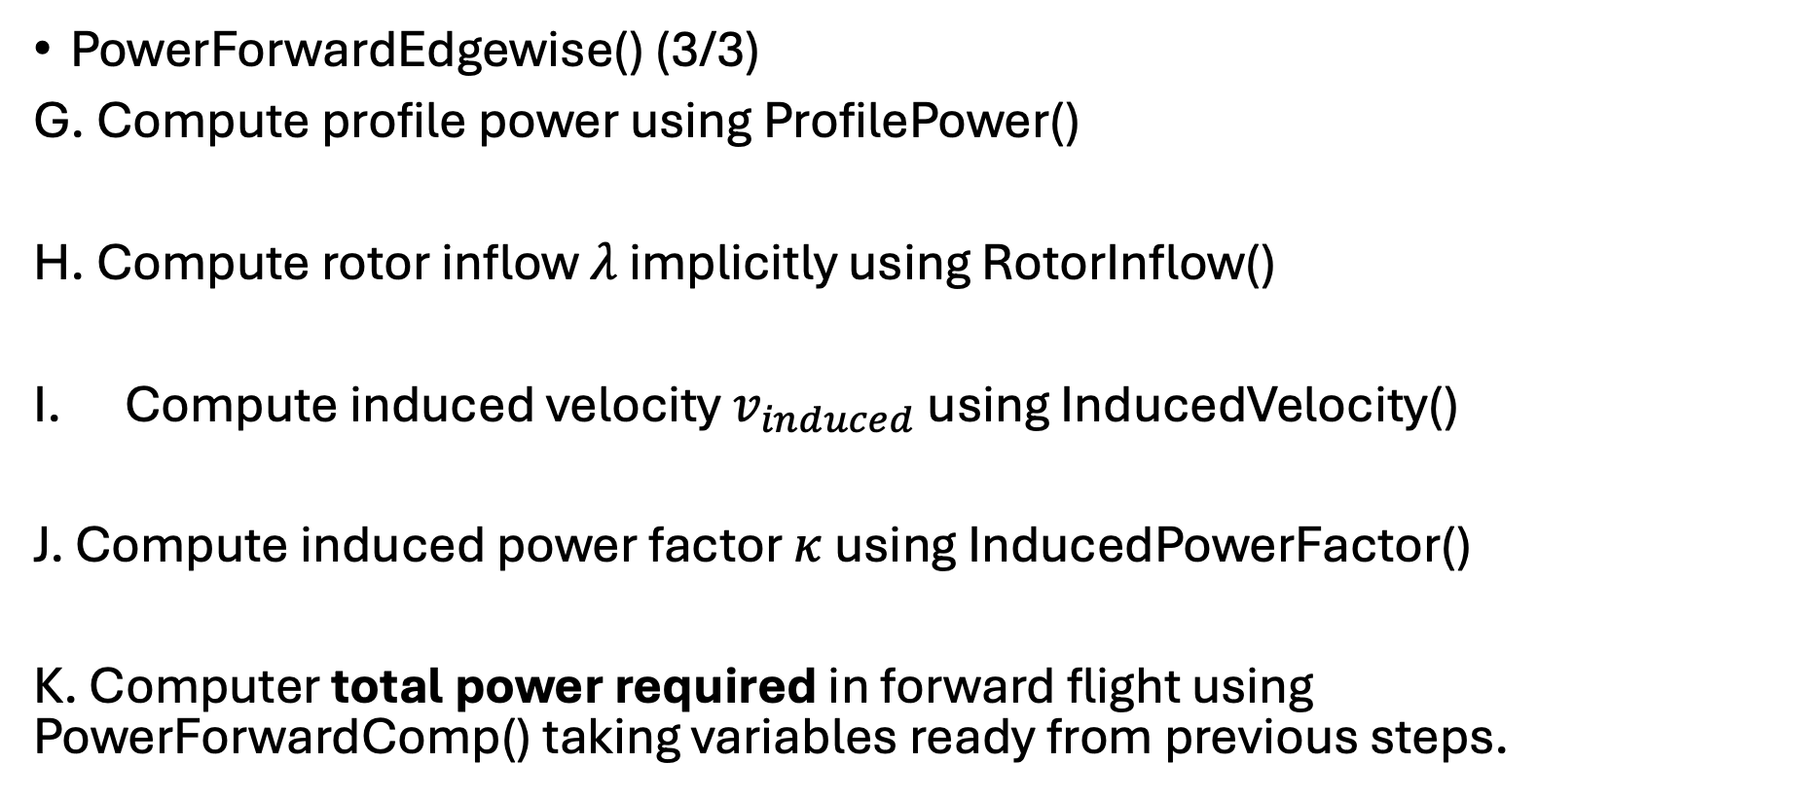
uavsizing.powers
openmdao.api.Group
PowerForwardEdgewise() (3/3)
G. Compute profile power using ProfilePower()
H. Compute rotor inflow $λ$ implicitly using RotorInflow()
Compute induced velocity $v_{induced}$ using InducedVelocity()
J. Compute induced power factor $κ$ using InducedPowerFactor()
K. Computer total power required in forward flight using PowerForwardComp() taking variables ready from previous steps.

Slide 33
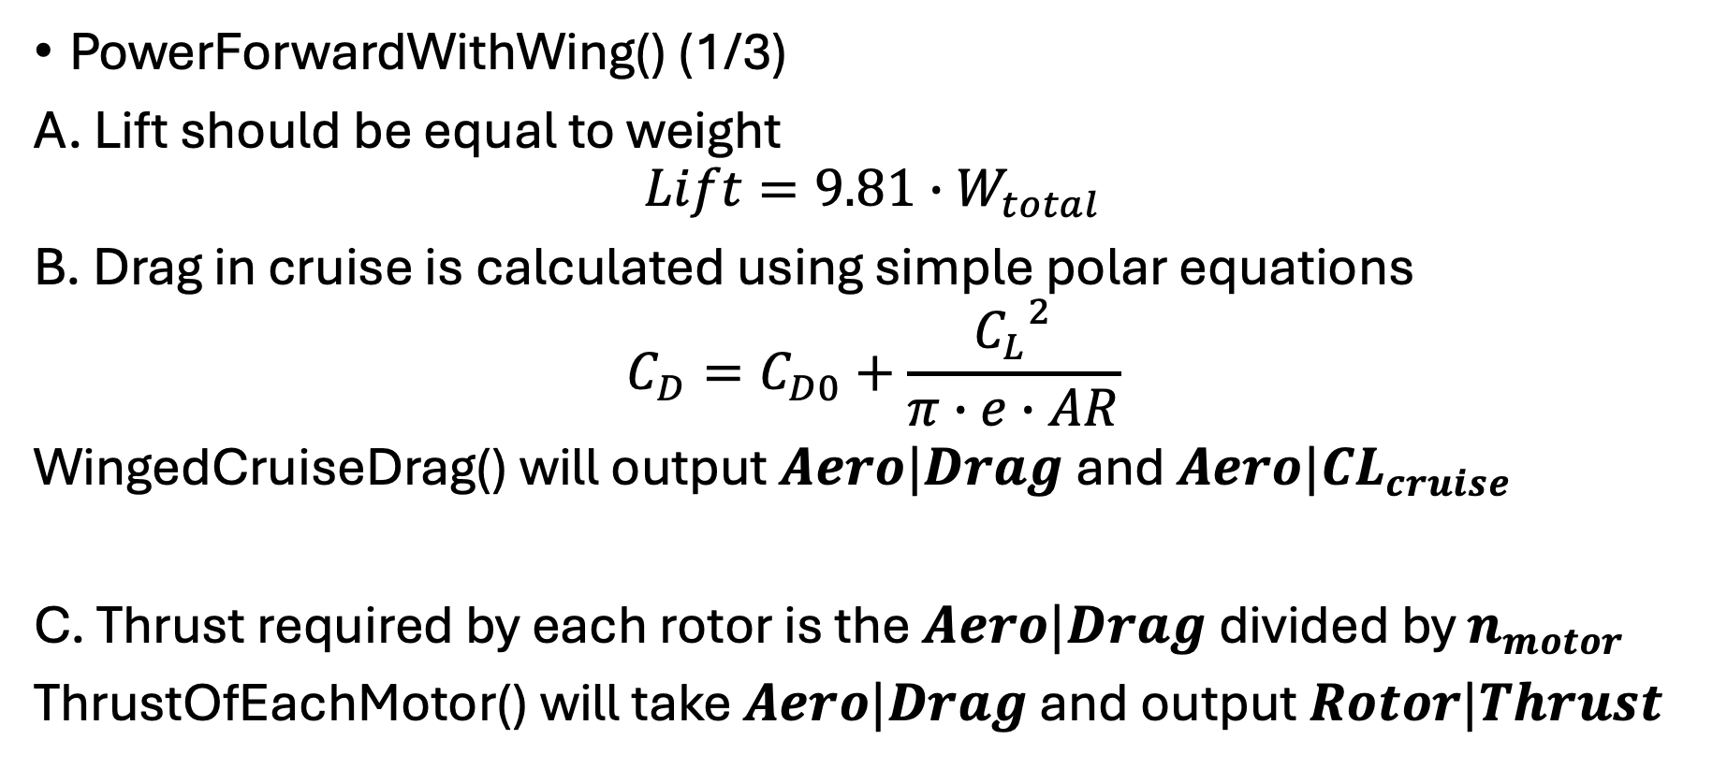
uavsizing.powers
openmdao.api.Group
PowerForwardWithWing() (1/3)
A. Lift should be equal to weight
$$Lift=9.81∙W_{total}$$
B. Drag in cruise is calculated using simple polar equations
$$C_{D}=C_{D0}+\frac{{C_{L}}^{2}}{π∙e∙AR}$$
WingedCruiseDrag() will output $Aero|Drag$ and $Aero|CL_{cruise}$
C. Thrust required by each rotor is the $Aero|Drag$ divided by $n_{motor}$
ThrustOfEachMotor() will take $Aero|Drag$ and output $Rotor|Thrust$

Slide 34
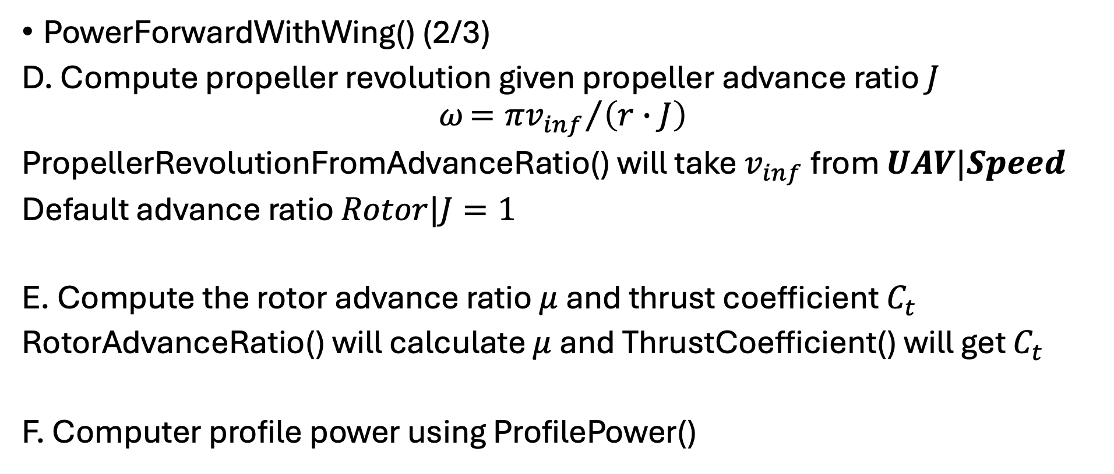
uavsizing.powers
openmdao.api.Group
PowerForwardWithWing() (2/3)
D. Compute propeller revolution given propeller advance ratio $J$
$$ω{={πv}_{inf}}/{\left(r∙J\right)}$$
PropellerRevolutionFromAdvanceRatio() will take $v_{inf}$ from $UAV|Speed$
Default advance ratio $Rotor|J=1$
E. Compute the rotor advance ratio $μ$ and thrust coefficient $C_{t}$
RotorAdvanceRatio() will calculate $μ$ and ThrustCoefficient() will get $C_{t}$
F. Computer profile power using ProfilePower()

Slide 35
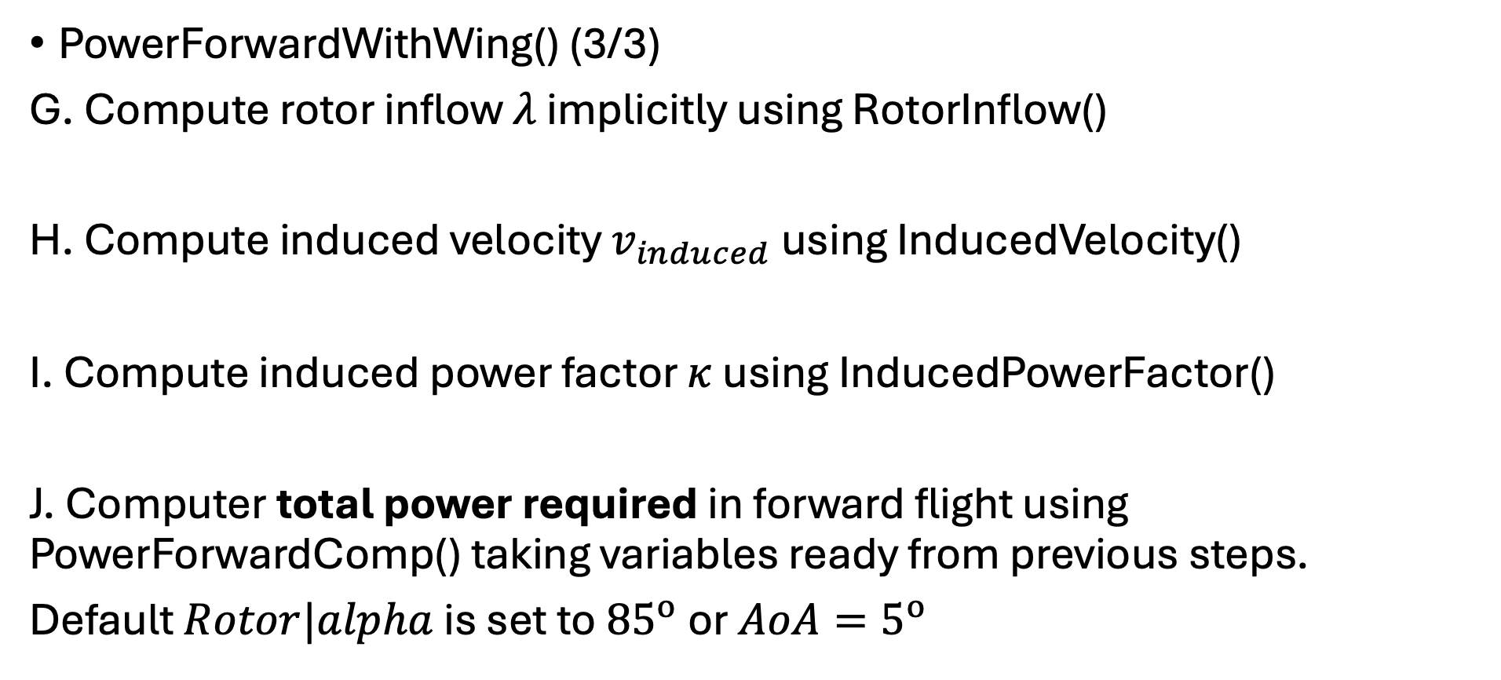
uavsizing.powers
openmdao.api.Group
PowerForwardWithWing() (3/3)
G. Compute rotor inflow $λ$ implicitly using RotorInflow()
H. Compute induced velocity $v_{induced}$ using InducedVelocity()
I. Compute induced power factor $κ$ using InducedPowerFactor()
J. Computer total power required in forward flight using PowerForwardComp() taking variables ready from previous steps.
Default $Rotor|alpha$ is set to ${85}^{o}$ or ${AoA=5}^{o}$

Slide 36
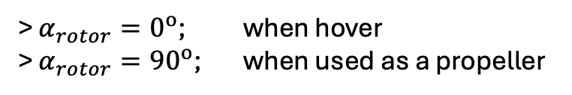
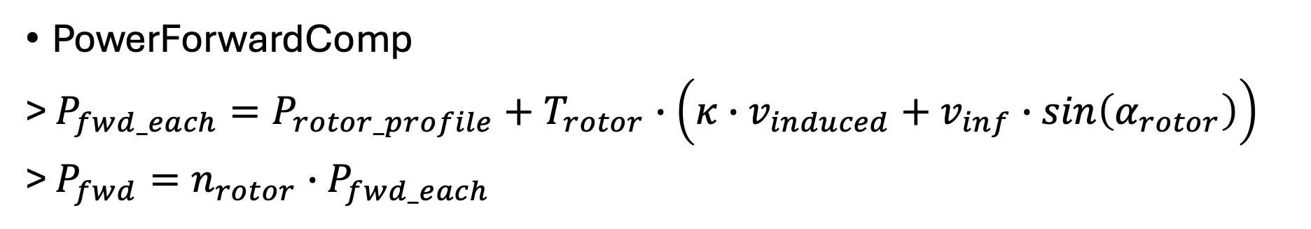
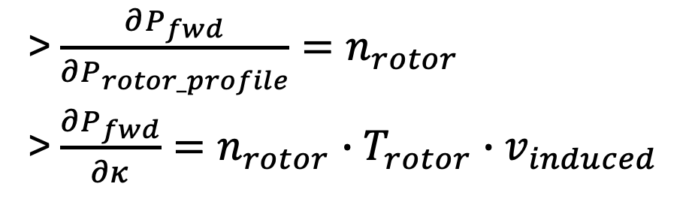
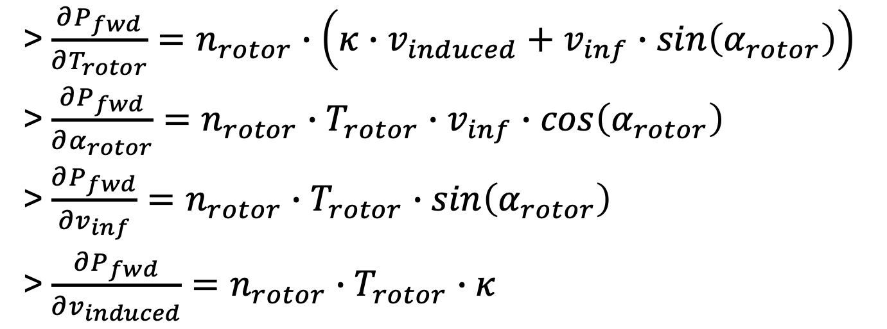
uavsizing.powers
openmdao.api.ExplicitComponent
> $α_{rotor}=0^{o}$; when hover
> $α_{rotor}={90}^{o}$; when used as a propeller
PowerForwardComp
> $P_{fwd_each}=P_{rotor_profile}+T_{rotor}∙\left(κ∙v_{induced}+v_{inf}∙sin\left(α_{rotor}\right)\right)$
> $P_{fwd}=n_{rotor}∙P_{fwd_each}$
> $\frac{∂P_{fwd}}{∂T_{rotor}}=n_{rotor}∙\left(κ∙v_{induced}+v_{inf}∙sin\left(α_{rotor}\right)\right)$
> $\frac{∂P_{fwd}}{∂α_{rotor}}=n_{rotor}∙T_{rotor}∙v_{inf}∙cos\left(α_{rotor}\right)$
> $\frac{∂P_{fwd}}{∂v_{inf}}=n_{rotor}∙T_{rotor}∙sin\left(α_{rotor}\right)$
> $\frac{∂P_{fwd}}{∂v_{induced}}=n_{rotor}∙T_{rotor}∙κ$
> $\frac{∂P_{fwd}}{∂P_{rotor_profile}}=n_{rotor}$
> $\frac{∂P_{fwd}}{∂κ}=n_{rotor}∙T_{rotor}∙v_{induced}$

Slide 37
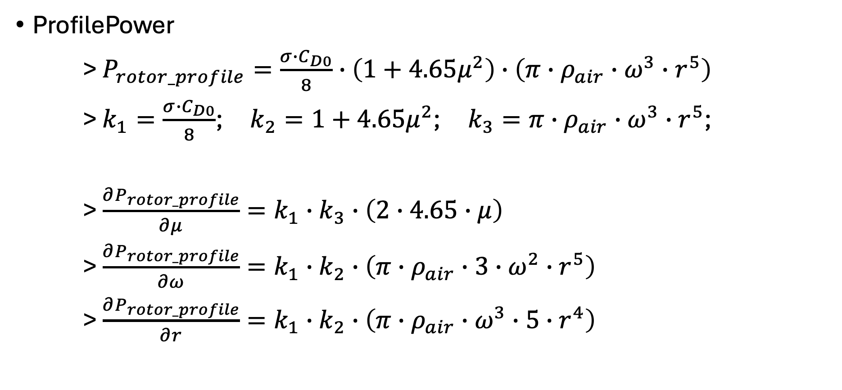
uavsizing.powers
openmdao.api.ExplicitComponent
ProfilePower
> $P_{rotor_profile}=\frac{σ∙C_{D0}}{8}∙\left(1+4.65μ^{2}\right)$ $∙\left(π∙ρ_{air}∙ω^{3}∙r^{5}\right)$
> $k_{1}=\frac{σ∙C_{D0}}{8}$; $k_{2}=1+4.65μ^{2}$; $k_{3}=π∙ρ_{air}∙ω^{3}∙r^{5}$;
> $\frac{∂P_{rotor_profile}}{∂μ}=k_{1}∙k_{3}∙\left(2∙4.65∙μ\right)$
> $\frac{∂P_{rotor_profile}}{∂ω}=k_{1}∙k_{2}∙\left(π∙ρ_{air}∙3∙ω^{2}∙r^{5}\right)$
> $\frac{∂P_{rotor_profile}}{∂r}=k_{1}∙k_{2}∙\left(π∙ρ_{air}∙ω^{3}∙5∙r^{4}\right)$

Slide 38
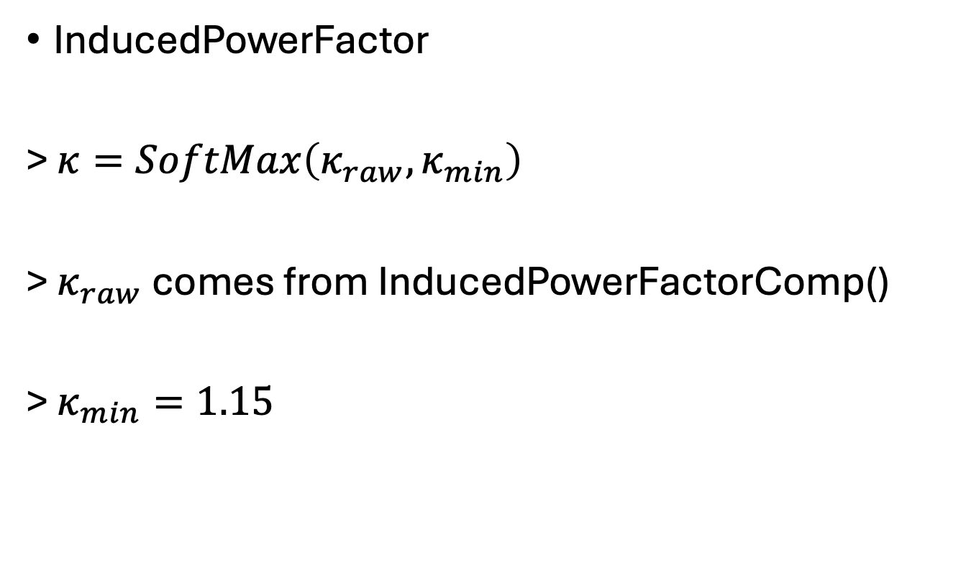
uavsizing.powers
openmdao.api.Group
InducedPowerFactor
> $κ=SoftMax\left(κ_{raw}, κ_{min}\right)$
> $κ_{raw}$ comes from InducedPowerFactorComp()
> $κ_{min}=1.15$

Slide 39
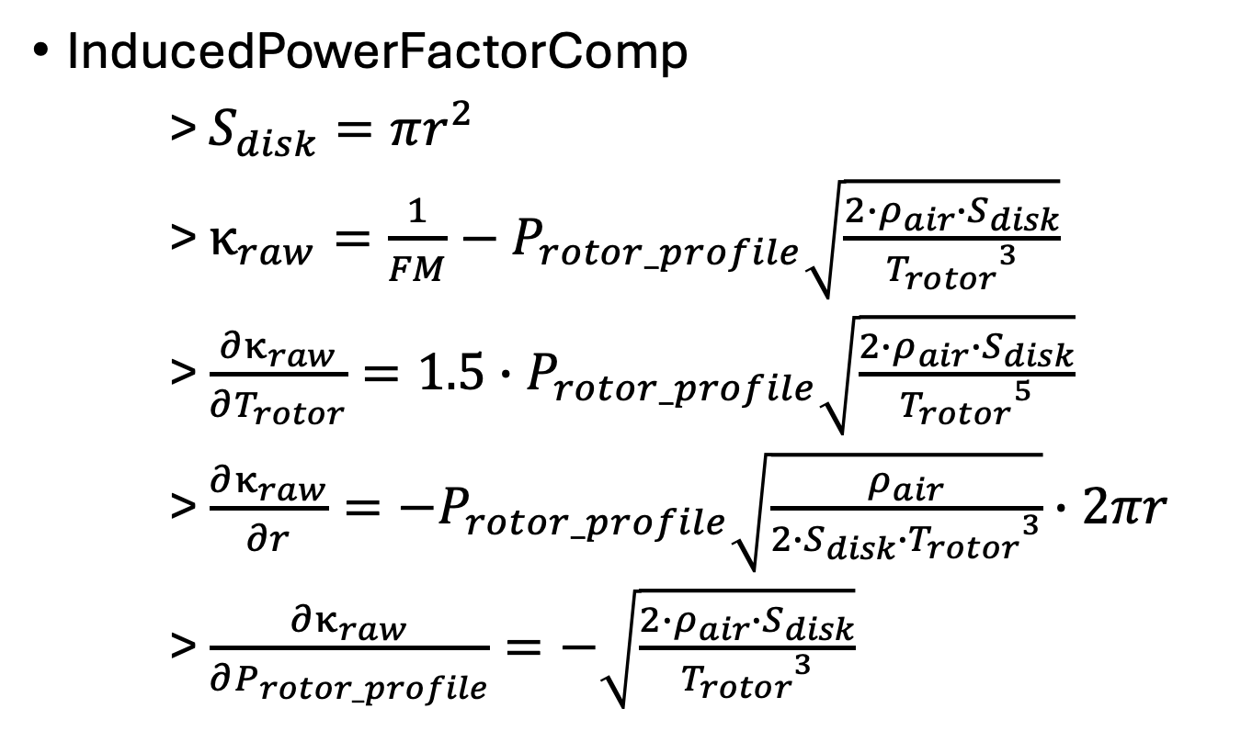
uavsizing.powers
openmdao.api.ExplicitComponent
InducedPowerFactorComp
> $S_{disk}=πr^{2}$
> $κ_{raw}=\frac{1}{FM}−P_{rotor_profile}\sqrt{\frac{2∙ρ_{air}∙S_{disk}}{{T_{rotor}}^{3}}}$
> $\frac{∂κ_{raw}}{∂T_{rotor}}={1.5∙P}_{rotor_profile}\sqrt{\frac{2∙ρ_{air}∙S_{disk}}{{T_{rotor}}^{5}}}$
> $\frac{∂κ_{raw}}{∂r}=−P_{rotor_profile}\sqrt{\frac{ρ_{air}}{{{{2∙S}_{disk}∙T}_{rotor}}^{3}}}∙2πr$
> $\frac{∂κ_{raw}}{∂P_{rotor_profile}}=−\sqrt{\frac{2∙ρ_{air}∙S_{disk}}{{T_{rotor}}^{3}}}$

Slide 40
uavsizing.energy

Slide 41
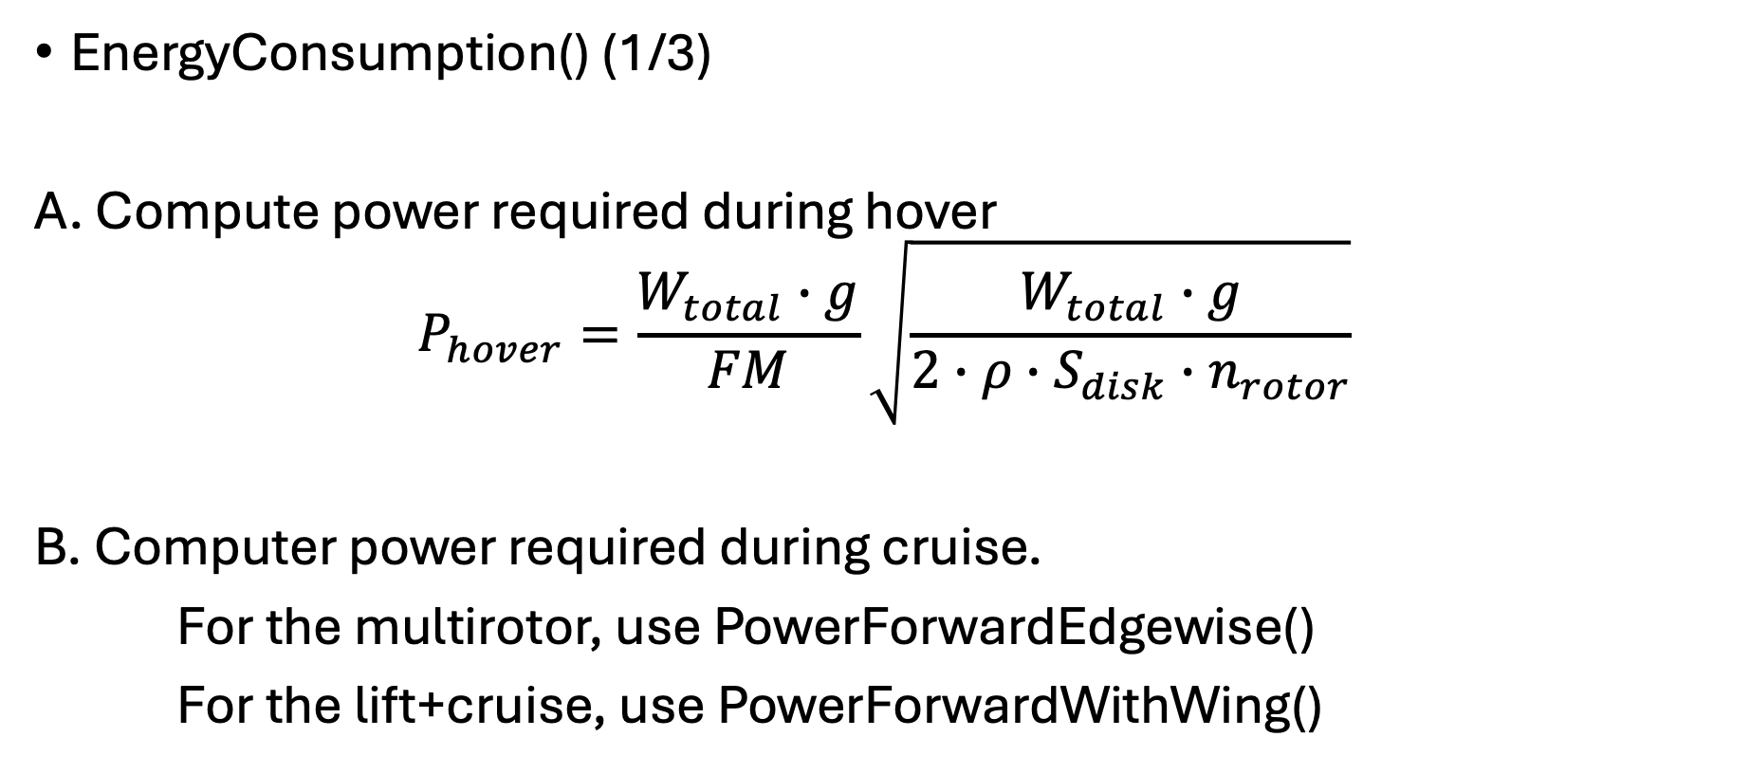
uavsizing.energy
openmdao.api.Group
EnergyConsumption() (1/3)
A. Compute power required during hover
$$P_{hover}=\frac{W_{total}∙g}{FM}\sqrt{\frac{W_{total}∙g}{2∙ρ∙S_{disk}∙n_{rotor}}}$$
B. Computer power required during cruise.
For the multirotor, use PowerForwardEdgewise()
For the lift+cruise, use PowerForwardWithWing()

Slide 42
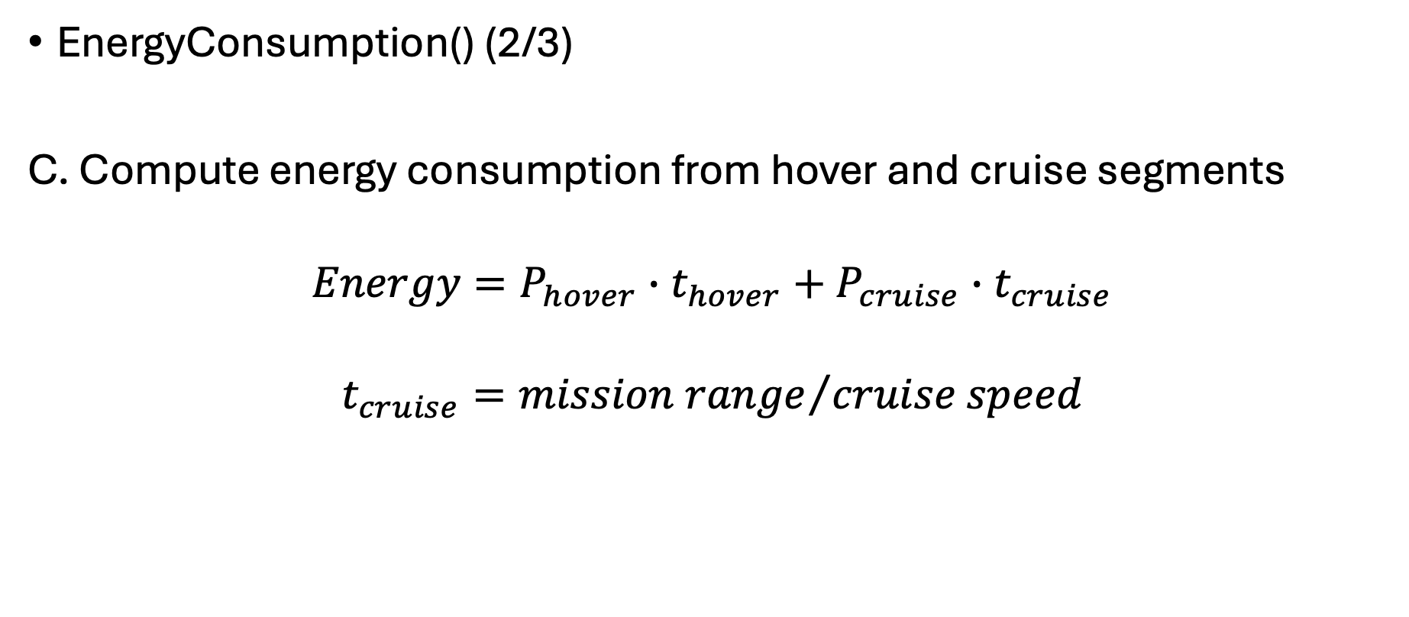
uavsizing.energy
openmdao.api.Group
EnergyConsumption() (2/3)
C. Compute energy consumption from hover and cruise segments
$$Energy=P_{hover}∙t_{hover}+P_{cruise}∙t_{cruise}$$
$$t_{cruise}={mission range}/{cruise speed}$$

Slide 43
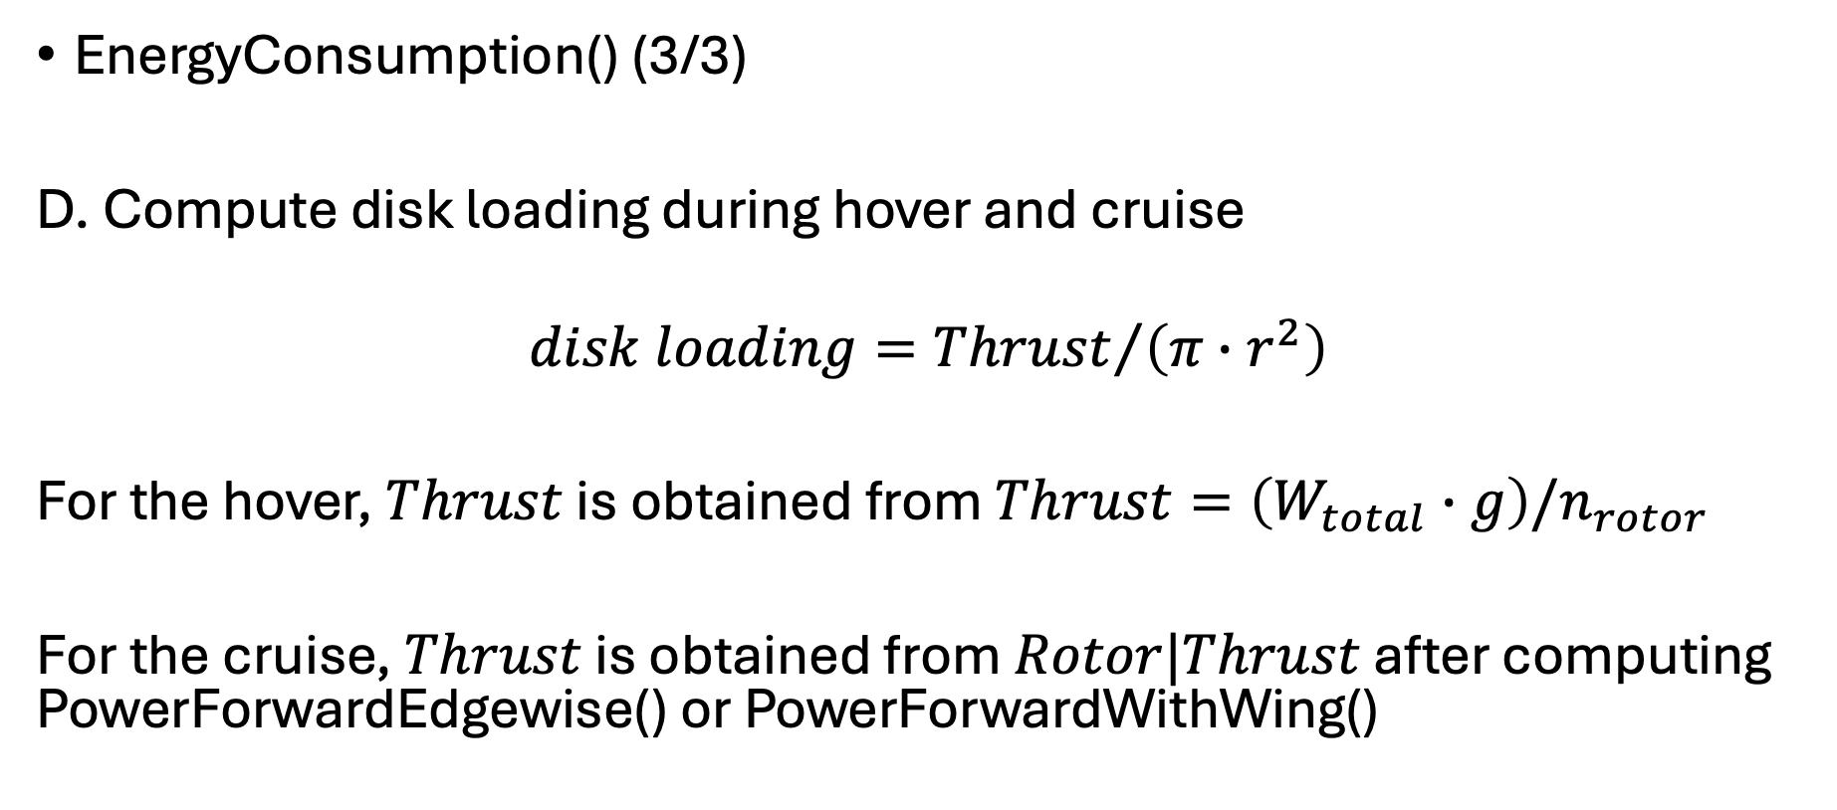
uavsizing.energy
openmdao.api.Group
EnergyConsumption() (3/3)
D. Compute disk loading during hover and cruise
$$disk loading={Thrust}/{\left(π∙r^{2}\right)}$$
For the hover, $Thrust$ is obtained from $Thrust=\left(W_{total}∙g\right)/n_{rotor}$
For the cruise, $Thrust$ is obtained from $Rotor|Thrust$ after computing PowerForwardEdgewise() or PowerForwardWithWing()

Slide 44
uavsizing.utils

Slide 45
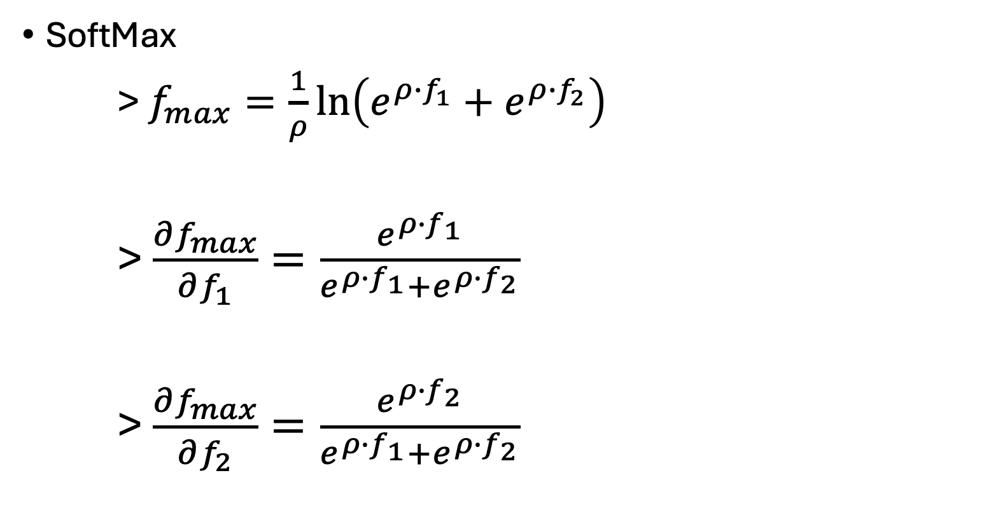
uavsizing.utils
openmdao.api.ExplicitComponent
SoftMax
> $f_{max}=\frac{1}{ρ}\ln\left(e^{ρ∙f_{1}}+e^{ρ∙f_{2}}\right)$
> $\frac{∂f_{max}}{∂f_{1}}=\frac{e^{ρ∙f_{1}}}{e^{ρ∙f_{1}}+e^{ρ∙f_{2}}}$
> $\frac{∂f_{max}}{∂f_{2}}=\frac{e^{ρ∙f_{2}}}{e^{ρ∙f_{1}}+e^{ρ∙f_{2}}}$

Slide 46
testcases

Slide 47




Lift+Cruise
UAV parameters
$$uav_config=′lift+cruise′$$
$$n_rotors_lift=4$$
$$n_rotors_cruise=2$$
$$rotor_lift_solidity=0.13$$
$$rotor_cruise_solidity=0.13$$
$$hover_FM=0.75$$
Wing parameters
$$Cd0=0.0397$$
$$wing_AR=6.0$$
$$wing_e=0.8$$
Mission requirements
$$payload_weight=2.0$$
$$flight_range=5000.0$$
$$hover_time=240.0$$
Battery parameters
$$battery_rho=158$$
$$battery_eff=0.85$$
$$battery_max⁡_discharge=0.7$$

Slide 48



Lift+Cruise
Design variables
$$0.1≤W_{total}≤20.0$$
$$2.0≤v_{cruise}≤30.0$$
$$0.05≤r_{rotor}≤0.25$$
$$0.05≤r_{propeller}≤0.25$$
$$0.01≤J≤1.3$$
$$0.01≤S_{wing}≤1.0$$
Minimize: $W_{total}$
Subject to: $W_{residual}=0$
${T/A}_{hover}≤250.0 N/m^{2}$
${T/A}_{cruise}≤250.0 N/m^{2}$
$0≤C_{T}≤0.14∙σ_{cruise}$
$0≤C_{L_cruise}≤0.6$
With respect to:
$$W_{total}, v_{cruise}, r_{rotor}, r_{propeller}, J, S_{wing}$$
Initial gueses
$$W_{total}=10.0 kg$$
$$v_{cruise}=25.0 m/s$$
$$r_{rotor}=0.2 m$$
$$r_{propeller}=0.2 m$$
$$J=1.0$$
$$S_{wing}=0.2 m^{2}$$

Slide 49



Lift+Cruise

Slide 50



Wingles Multirotor
UAV parameters
$$uav_config=′multirotor′$$
$$n_rotors_lift=6$$
$$rotor_lift_solidity=0.13$$
$$hover_FM=0.75$$
Mission requirements
$$payload_weight=2.0$$
$$flight_range=5000.0$$
$$hover_time=240.0$$
Battery parameters
$$battery_rho=158$$
$$battery_eff=0.85$$
$$battery_max⁡_discharge=0.7$$

Slide 51



Wingless Multirotor
Design variables
$$0.1≤W_{total}≤20.0$$
$$2.0≤v_{cruise}≤30.0$$
$$0.05≤r_{rotor}≤0.25$$
$$0.01≤μ≤0.5$$
Minimize: $W_{total}$
Subject to: $W_{residual}=0$
${T/A}_{hover}≤250.0 N/m^{2}$
${T/A}_{cruise}≤250.0 N/m^{2}$
$0≤C_{T}≤0.14∙σ_{cruise}$
With respect to:
$W_{total}, v_{cruise}, r_{rotor}, μ$
Initial gueses
$$W_{total}=10.0 kg$$
$$v_{cruise}=5.0 m/s$$
$$r_{rotor}=0.1 m$$
$$μ =0.2$$

Slide 52



Wingless Multirotor

Slide 53






Energy vs Range
UAV_1 parameters
$$uav_config=′multirotor′$$
$$n_rotors_lift=6$$
$$rotor_lift_solidity=0.13$$
$$hover_FM=0.75$$
UAV_2 parameters
$$uav_config=′lift+cruise′$$
$$n_rotors_lift=4$$
$$n_rotors_cruise=2$$
$$rotor_lift_solidity=0.13$$
$$rotor_cruise_solidity=0.13$$
$$hover_FM=0.75$$
$$Cd0=0.0397$$
$$wing_AR=6.0$$
$$wing_e=0.8$$
Battery parameters
$$battery_rho=158$$
$$battery_eff=0.85$$
$$battery_max⁡_discharge=0.7$$
Mission requirements
$$flight_range=[100,5000,15]$$
$$hover_time=240.0$$
UAV_1 designs
$$uav1_weight=5.0$$
$$uav1_r_rotor=0.2$$
$$uav1_speed=10.0$$
$$uav1_rotor_mu=0.3$$
UAV_2 designs
$$uav2_weight=5.0$$
$$uav2_r_rotor_lift=0.2$$
$$uav2_r_rotor_cruise=0.2$$
$$uav2_speed=20.0$$
$$uav2_wing_area=0.2$$
$$uav2_rotor_J=1.0$$

Slide 54

Energy vs Range

Slide 55




MTOW vs Range
UAV_1 parameters
$$uav_config=′multirotor′$$
$$n_rotors_lift=6$$
$$rotor_lift_solidity=0.13$$
$$hover_FM=0.75$$
UAV_2 parameters
$$uav_config=′lift+cruise′$$
$$n_rotors_lift=4$$
$$n_rotors_cruise=2$$
$$rotor_lift_solidity=0.13$$
$$rotor_cruise_solidity=0.13$$
$$hover_FM=0.75$$
$$Cd0=0.0397$$
$$wing_AR=6.0$$
$$wing_e=0.8$$
Battery parameters
$$battery_rho=158$$
$$battery_eff=0.85$$
$$battery_max⁡_discharge=0.7$$
Mission requirements
$$payload_weight=2.0$$
$$flight_range=[100,5000,15]$$
$$hover_time=240.0$$
UAV_1 designs
$$uav1_r_rotor=0.2$$
$$uav1_speed=10.0$$
$$uav1_rotor_mu=0.3$$
UAV_2 designs
$$uav2_r_rotor_lift=0.2$$
$$uav2_r_rotor_cruise=0.2$$
$$uav2_speed=20.0$$
$$uav2_wing_area=0.2$$
$$uav2_rotor_J=1.0$$

Slide 56

MTOW vs Range

